Slide 1
Java Persistence API

Slide 2
Objectives
Explain what JPA is and its role in data persistence for Java applications.
Highlight the advantages of using JPA over traditional JDBC approaches.
Define and illustrate core JPA concepts like entities, annotations, persistence context, entity manager and JPQL.
Provide a clear understanding of how these components work together to manage data.
Show how JPA simplifies development by reducing boilerplate code and allowing focus on business logic.

Slide 3
Contents
Introduction
Key Concepts
Annotations
Relationships
Using JPA
Demo
Advantages and Disadvantages

Slide 4
Object Relational Mapping (ORM)

Slide 5
Benefits of ORM
Increased Productivity: You write less code because ORM handles the low-level data access tasks.
Improved Maintainability: Your code is cleaner and easier to understand because it focuses on the business logic, not database details.
Enhanced Performance: ORM frameworks can optimize data access and caching, potentially improving performance.
Database Independence: You can switch databases without rewriting your application code (to some extent)

Slide 6
Popular ORM Frameworks for Java
Hibernate: The most widely used JPA implementation, offering a rich feature set and extensive customization options.
EclipseLink: Another JPA implementation with a focus on standards compliance and portability.
Spring Data JPA: An abstraction layer on top of JPA providers, simplifying data access and reducing boilerplate code.
DataNucleus providing easy persistence to RDBMS datastores. Comes with its own "SQL-like" JPQL query language, so you query your data in a language similar to what your datastore understands.

Slide 7
Java Persistence API (JPA)

Slide 8
What is JPA ?
JPA stands for Java Persistence API. It is a Java programming interface that allows developers to manage relational data in Java applications using object oriented methodologies.
JPA is a specification for managing relational data in Java applications. It provides a set of interfaces, annotations, and an object relational mapping (ORM) framework that simplifies the process of interacting with databases.

Slide 9
Key Feature of JPA
ORM: JPA allows you to map Java objects (entities) to relational database tables, abstracting away the differences between the object-oriented and relational models.
Annotations: You can use annotations to define entities, relationships and other persistence related metadata.
EntityManager: The interface provides methods for persisting, retrieving, updating, and deleting entities.
JPQL is an object oriented query language that allows you to query entities and their relationships.
Transaction Management: JPA supports transaction management, ensuring data integrity and consistency.

Slide 10
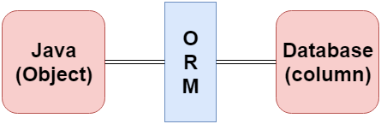
JPA Object Relational Mapping
ORM makes it easier to work with databases in object-oriented applications, allowing you to focus on the business logic rather than the underlying data storage details.

Slide 11
Benefits of Using JPA
Simplified Data Access: JPA makes it easier to work with relational data in Java applications by providing a higher-level abstraction.
Code Portability: JPA is a standard specification, so code written using JPA can be portable across different JPA providers.
Reduced Boilerplate Code: JPA annotations and the EntityManager interface reduce the amount of code needed for data access.
Improved Data Integrity: JPA's transaction management and validation features help ensure data integrity.
Enhanced Performance: Caching and other optimization techniques can improve the performance of JPA applications.

Slide 12
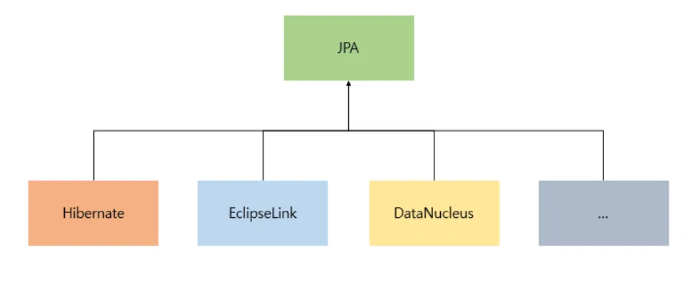
JPA Implementation Options

Slide 13
Entity Annotations in JPA
@Entity: This annotation marks a Java class as an entity, meaning it represents a table in the database.
@Table: This annotation allows you to specify the name of the database table that an entity maps to.
@Transient: This annotation marks a property that should not be persisted to the database.
@NamedQueries and @NamedQuery: These annotations allow you to define named queries that can be used to retrieve entities.

Slide 14
Mapping Annotations in JPA
@Id: This annotation marks a Java class as an entity, meaning it represents a table in the database.
@Column: This annotation defines the mapping between a property of an entity and a column in the database table. You can use it to specify the column name, data type, and other attributes.
@Basic: This annotation specifies that a property is a basic type and should be persisted.
@Enumerated: This annotation is used to map an Enum type to a database column.

Slide 15
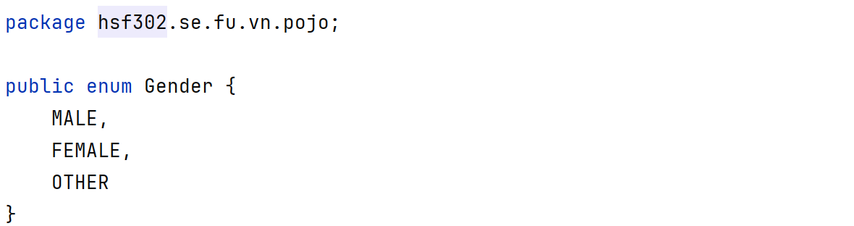
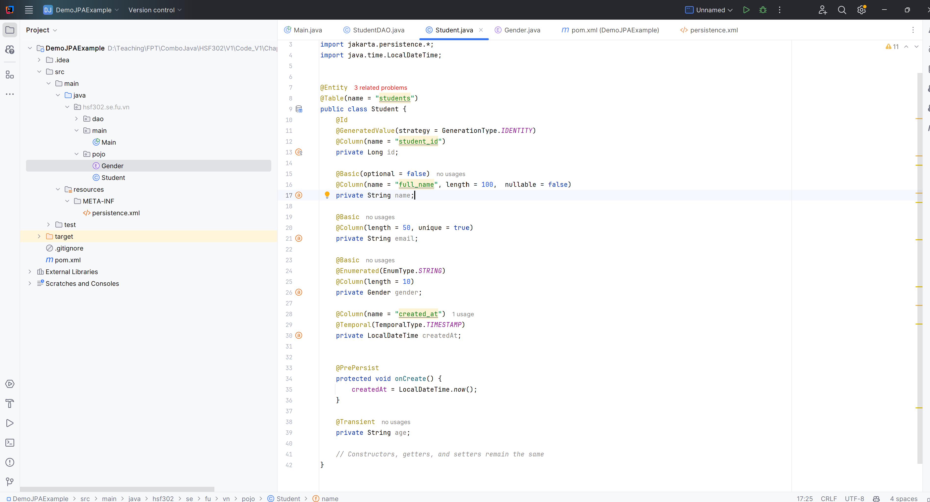
Example

Slide 16
JPA Entity Manager
The entity manager implements the API and encapsulates all of them within a single interface.
Manages entity lifecycle: Persist, find, merge, remove
Controls persistence context: Cache, flush, detach
Executes queries: JPQL, Criteria API
Handles transactions: Begin, commit, rollback
Provides access to entity metadata

Slide 17
Key Operations of the Entity Manager
Persisting Entities: em.persist(entity) makes a transient entity instance persistent
Finding Entities: em.find(entityClass,primaryKey) retrieves an entity by its primary key.
Merging Entities: em.merge(entity) merges a detached entity instance into the current persistence context.
Removing Entities: em.remove(entity) removes a persistent entity instance.
Querying Data: em.createQuery(jpqlString) creates a JPQL query to retrieve entities based on specified criteria.

Slide 18
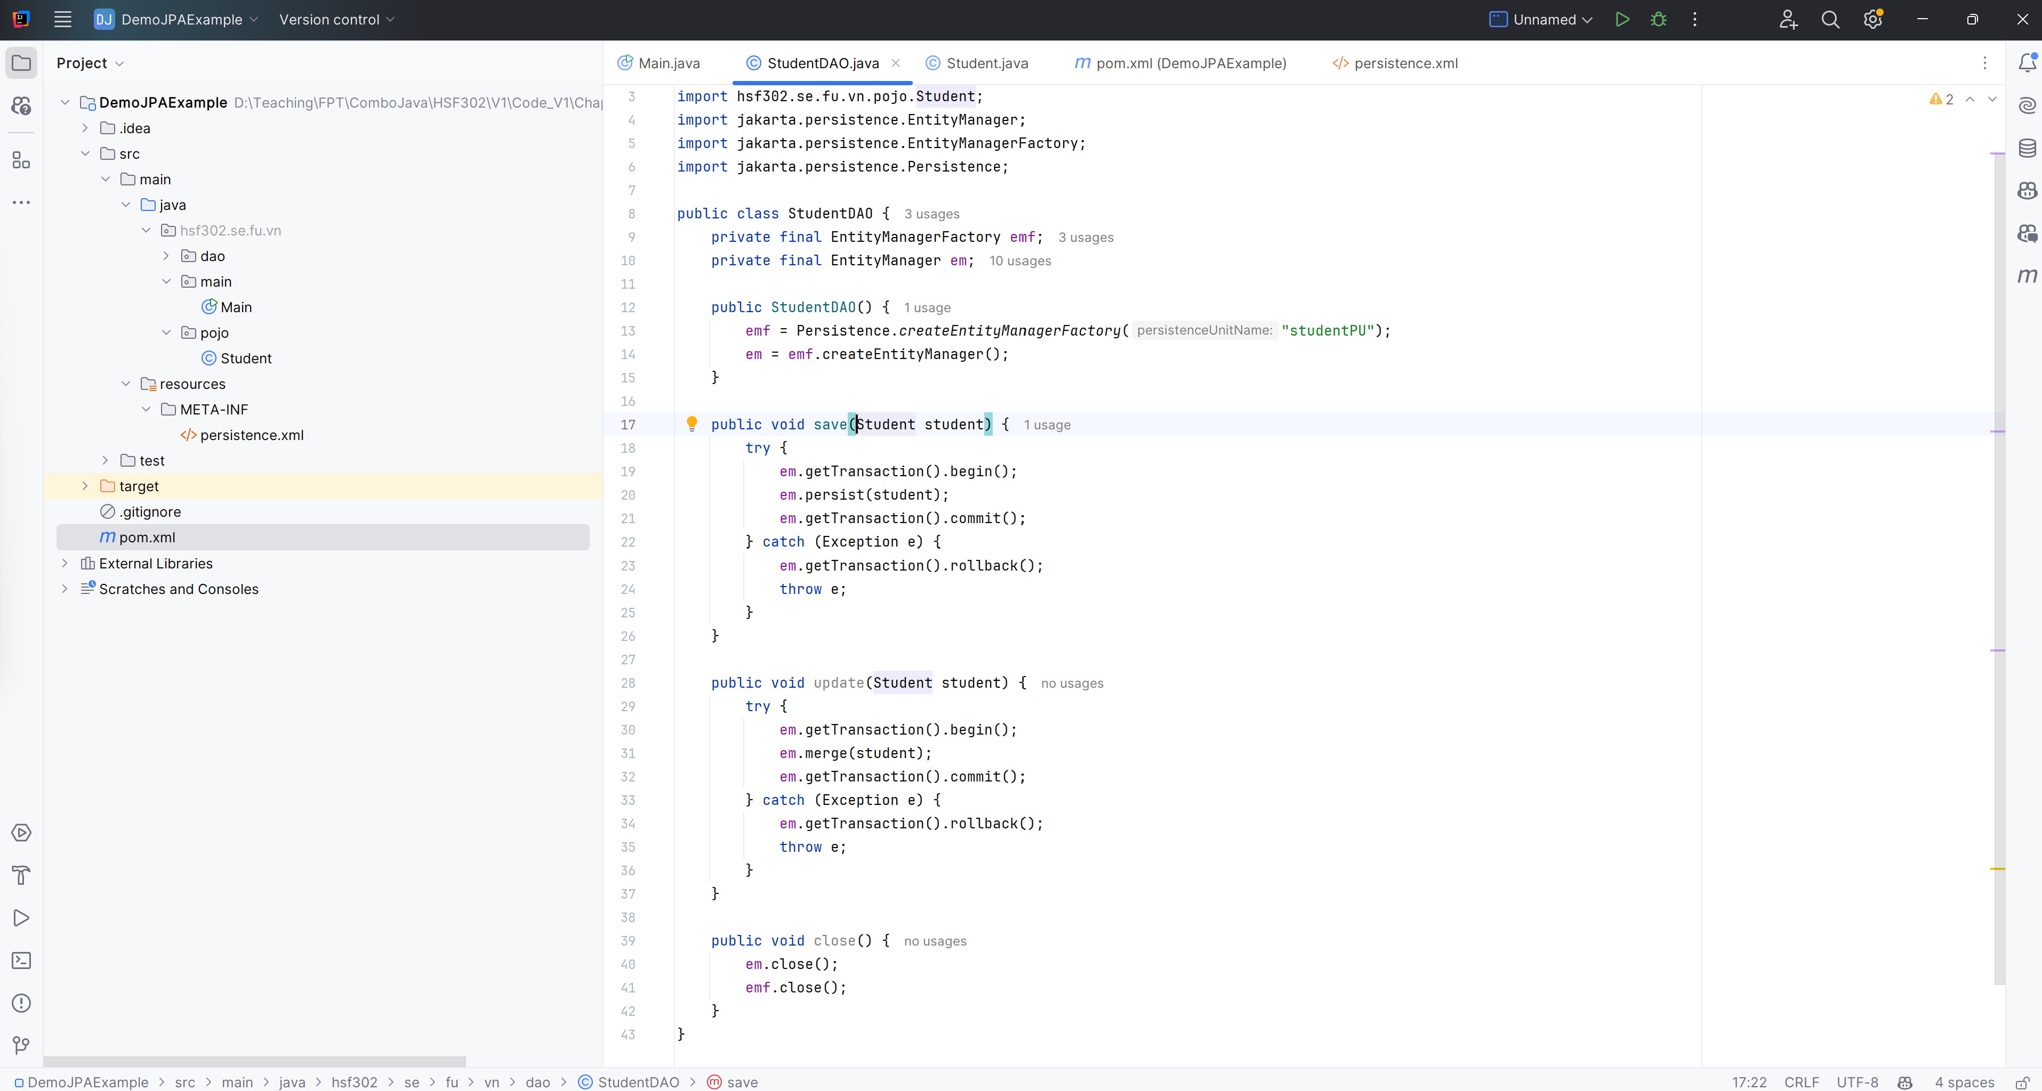
Example

Slide 19
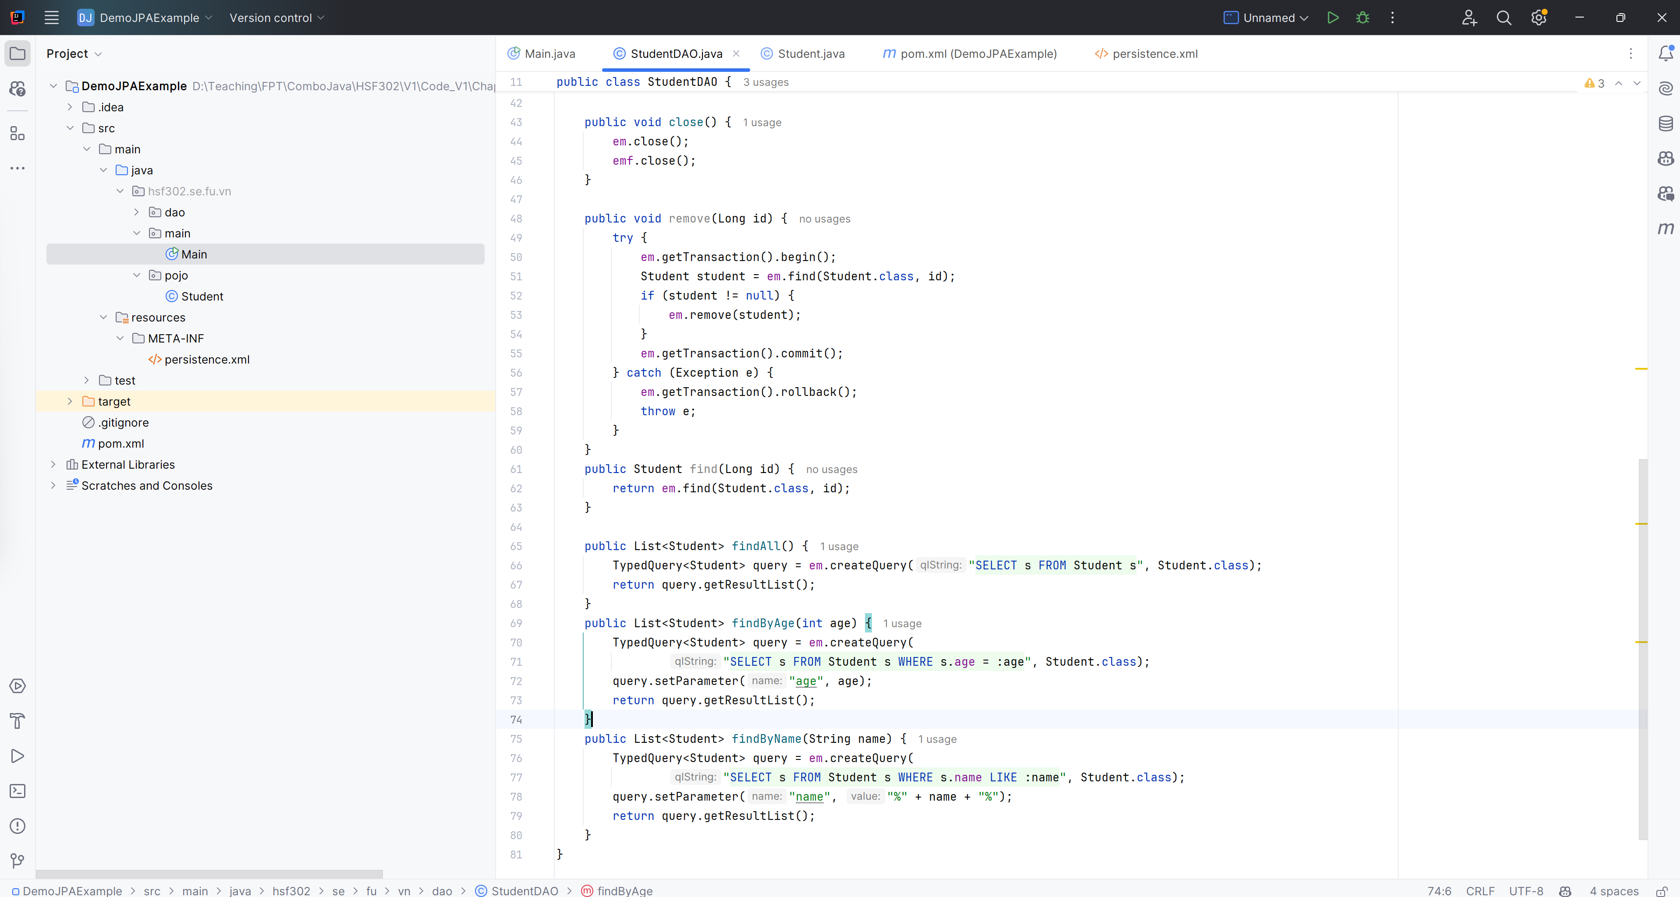
Example

Slide 20
JPA Versions and Key Features
JPA Version | Release Year | Key Features
JPA 1.0 | 2006 | Core ORM functionality: entities, mappings, relationships, inheritance, JPQL, EntityManager
JPA 2.0 | 2009 | Enums, Criteria API, embeddable collections, derived properties, validation, metamodel
JPA 2.1 | 2013 | Entity graphs, converters, stored procedures, Java 8 date/time
JPA 2.2 | 2019 | Streamlined bootstrap, Java 9 modules
JPA 3.0 | 2022 | Renamed to Jakarta Persistence, Java records, Java 17 support

Slide 21
Demo Simple CRUD with JPA

Slide 22
Requirements
JDK : 21
JPA : 3.1
MSSQL : 11.2.3
Hibernate: 6.5.2

Slide 23
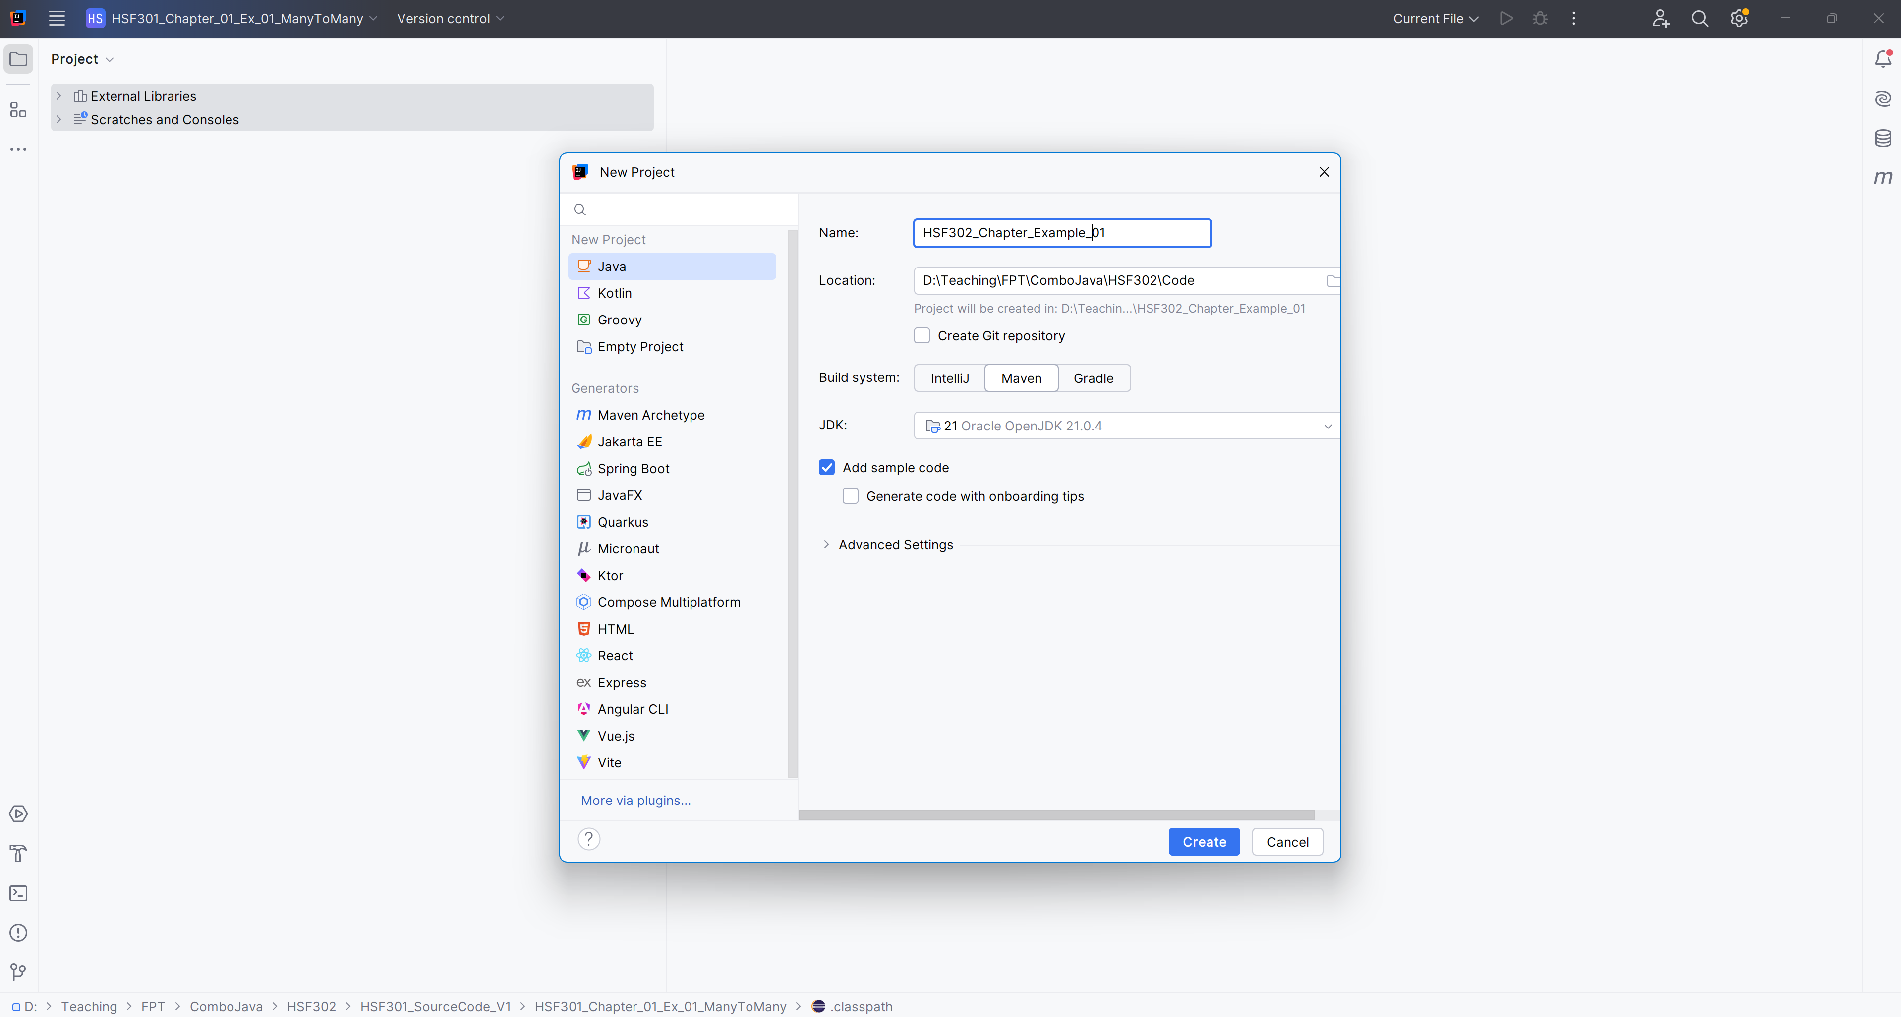
Open IntelliJ, File | New | Maven Project

Slide 24
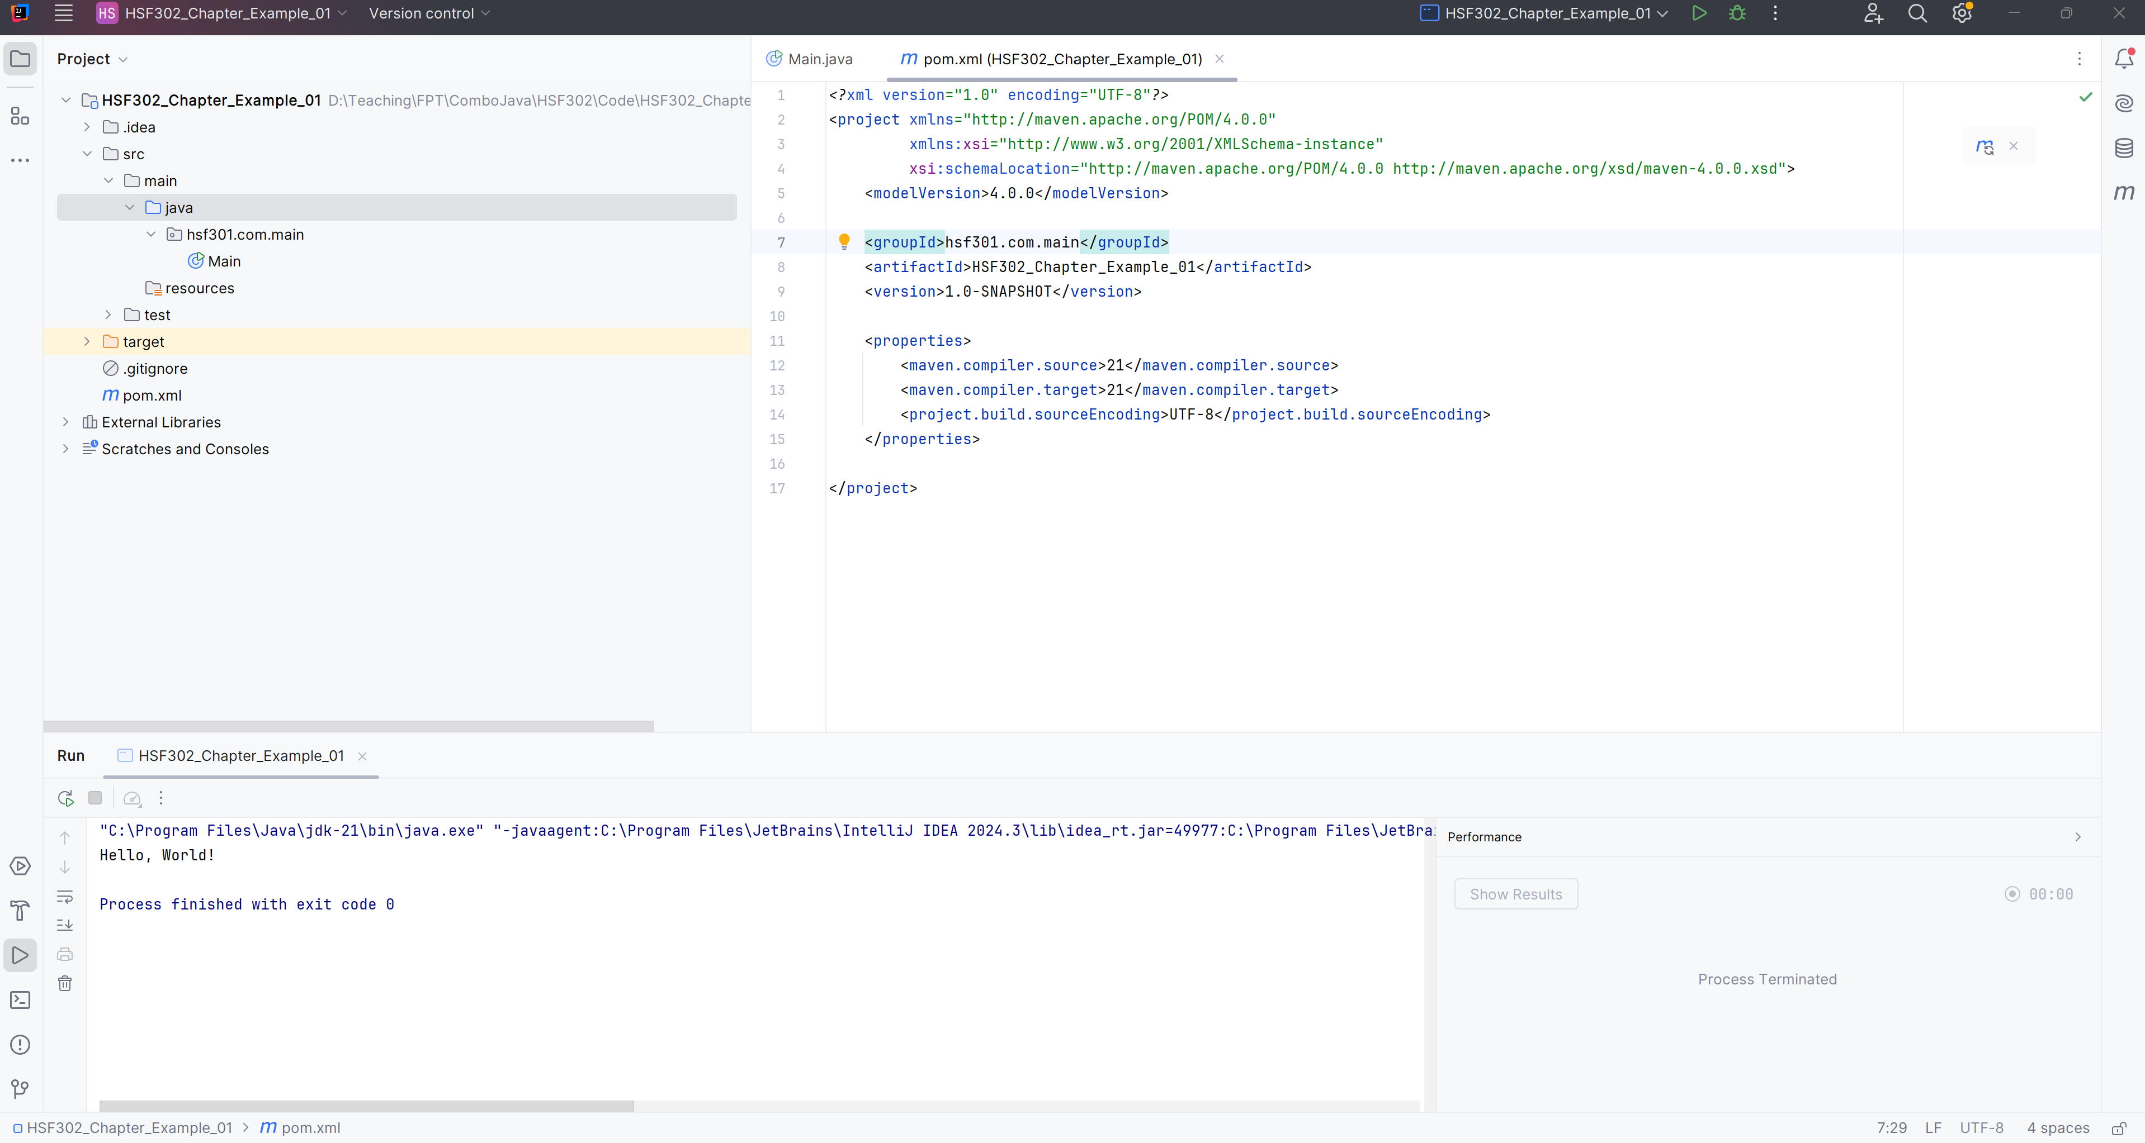
The New Project

Slide 25
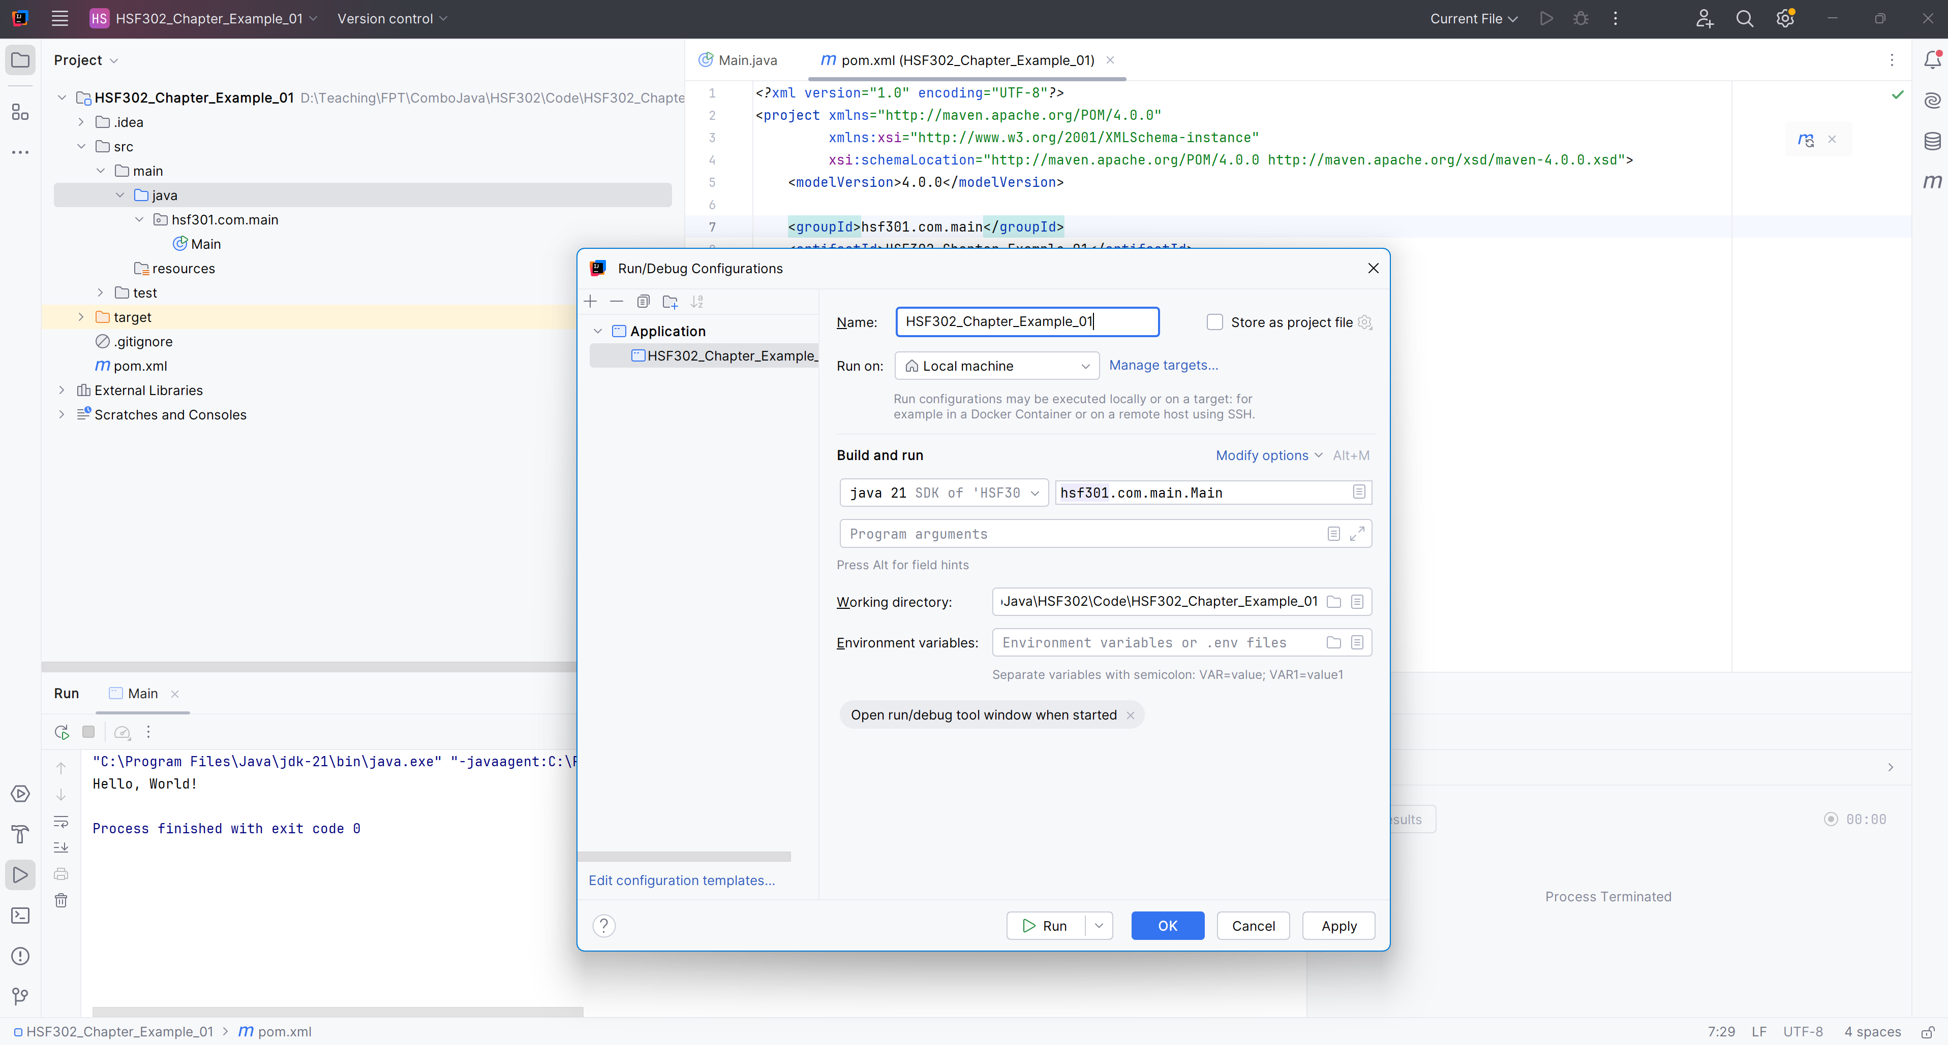
Add Run Configurations

Slide 26
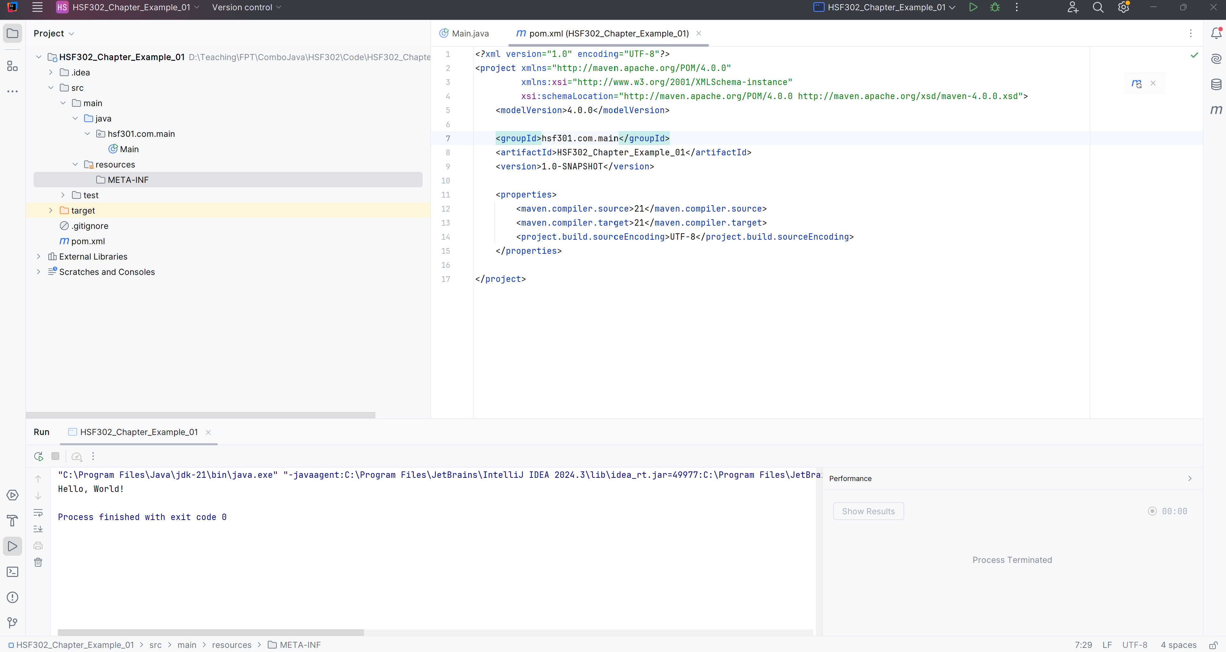
Create folder META-INF in src/main/resources

Slide 27
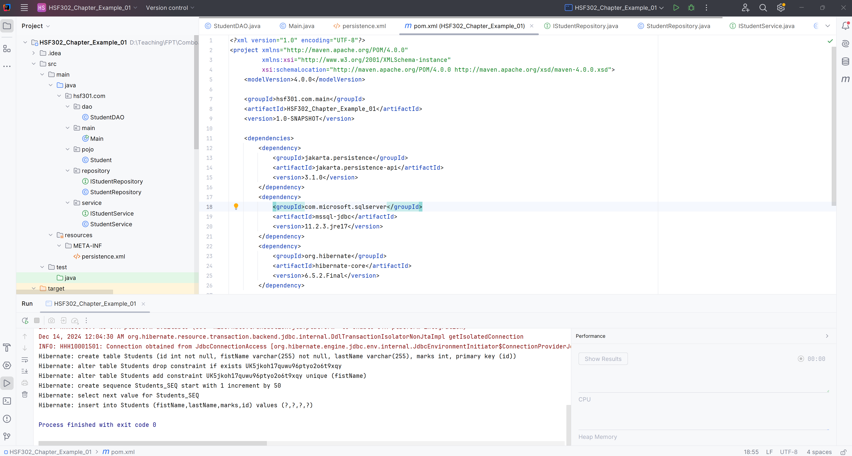
Edit the pom.xml

Slide 28
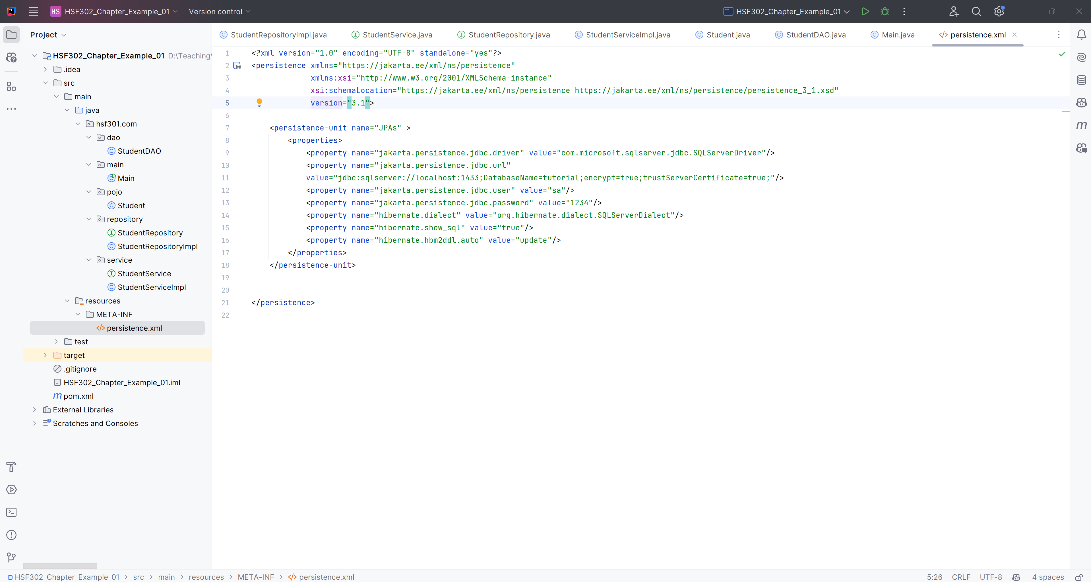
Create the persistence.xml in META-INF folder

Slide 29
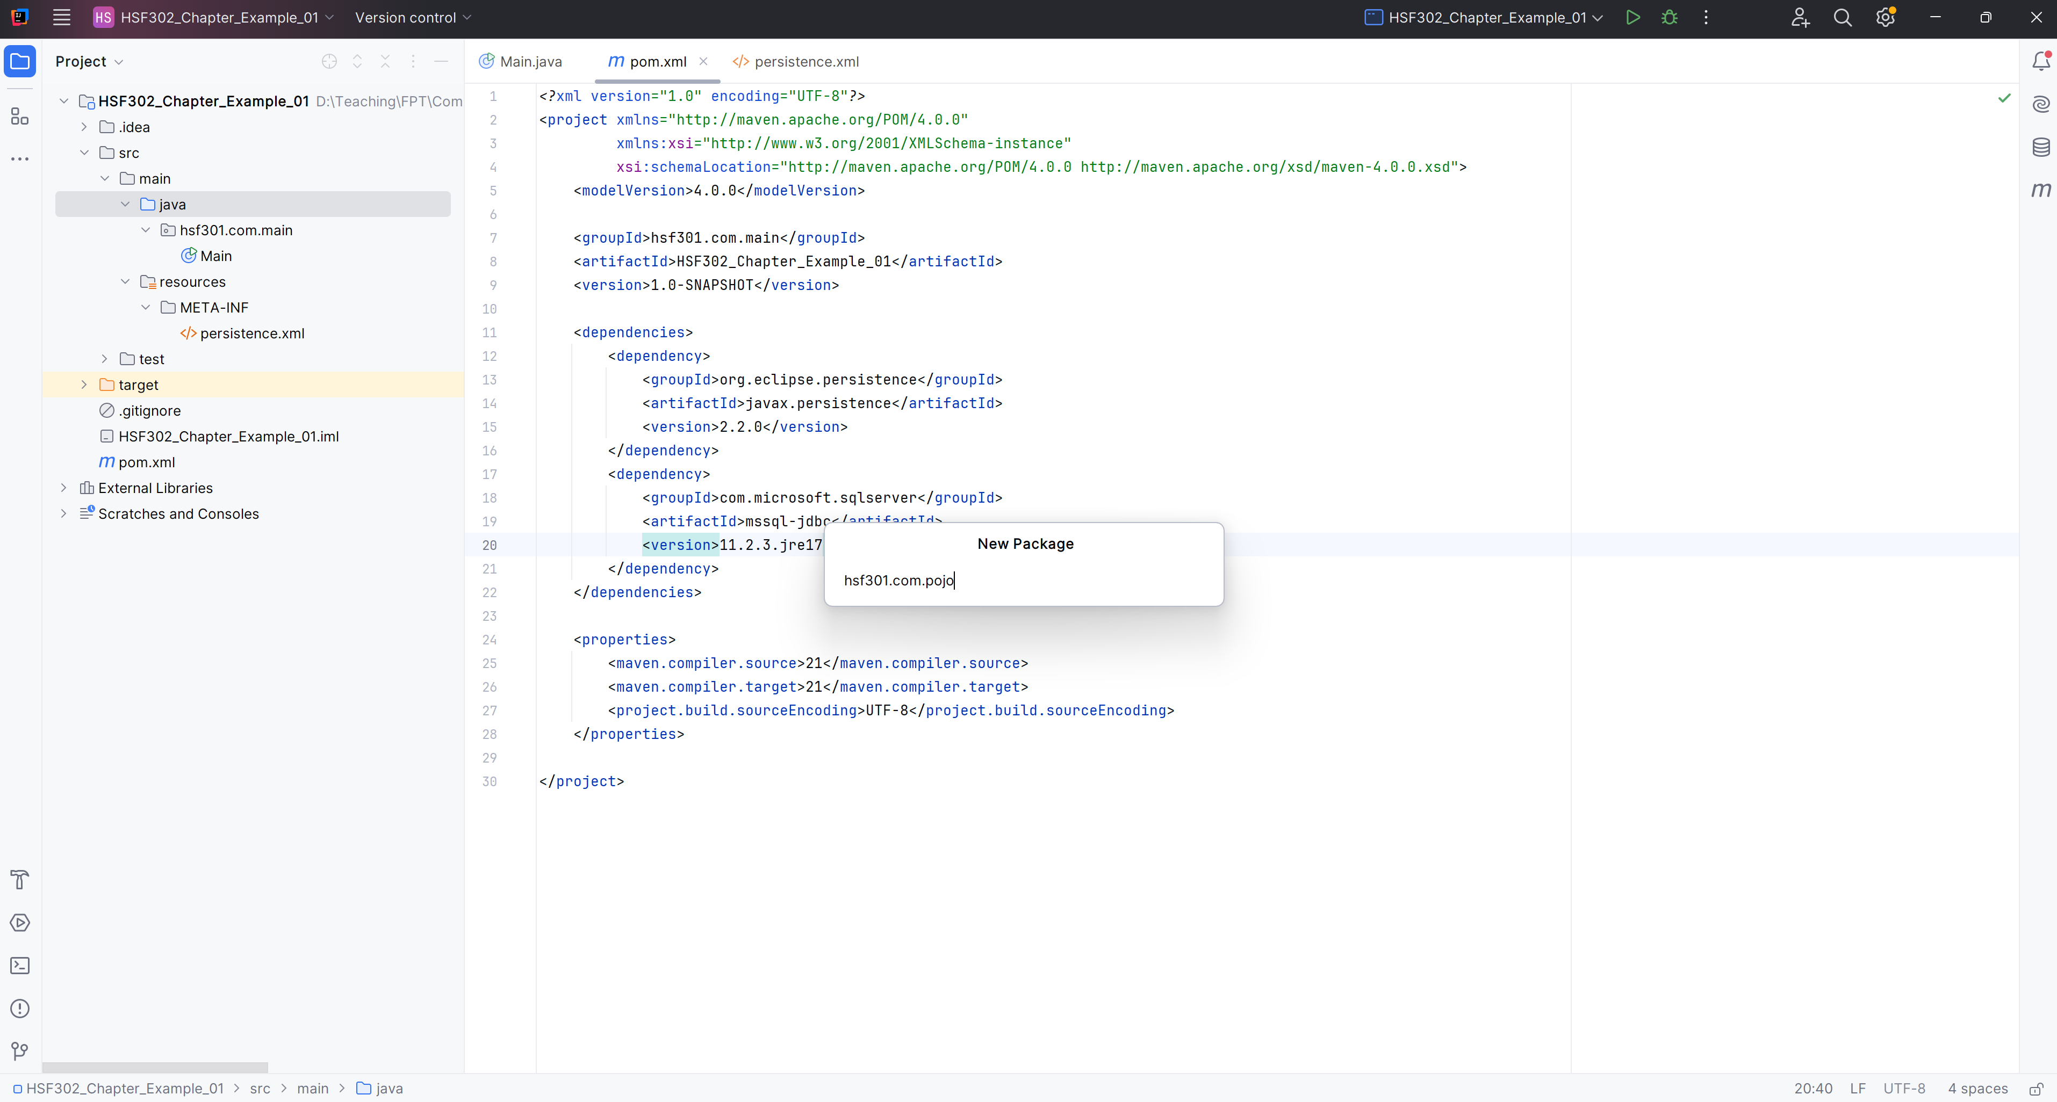
Add hsf301.com.pojo Package in src/main/java

Slide 30
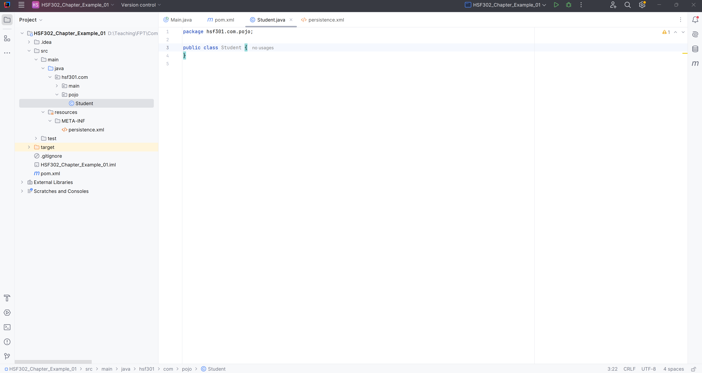
Add Student.java in hsf301.com.pojo package

Slide 31
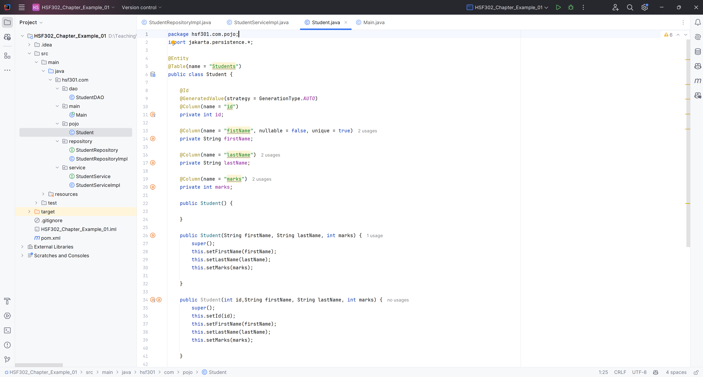
Edit the Student.java

Slide 32
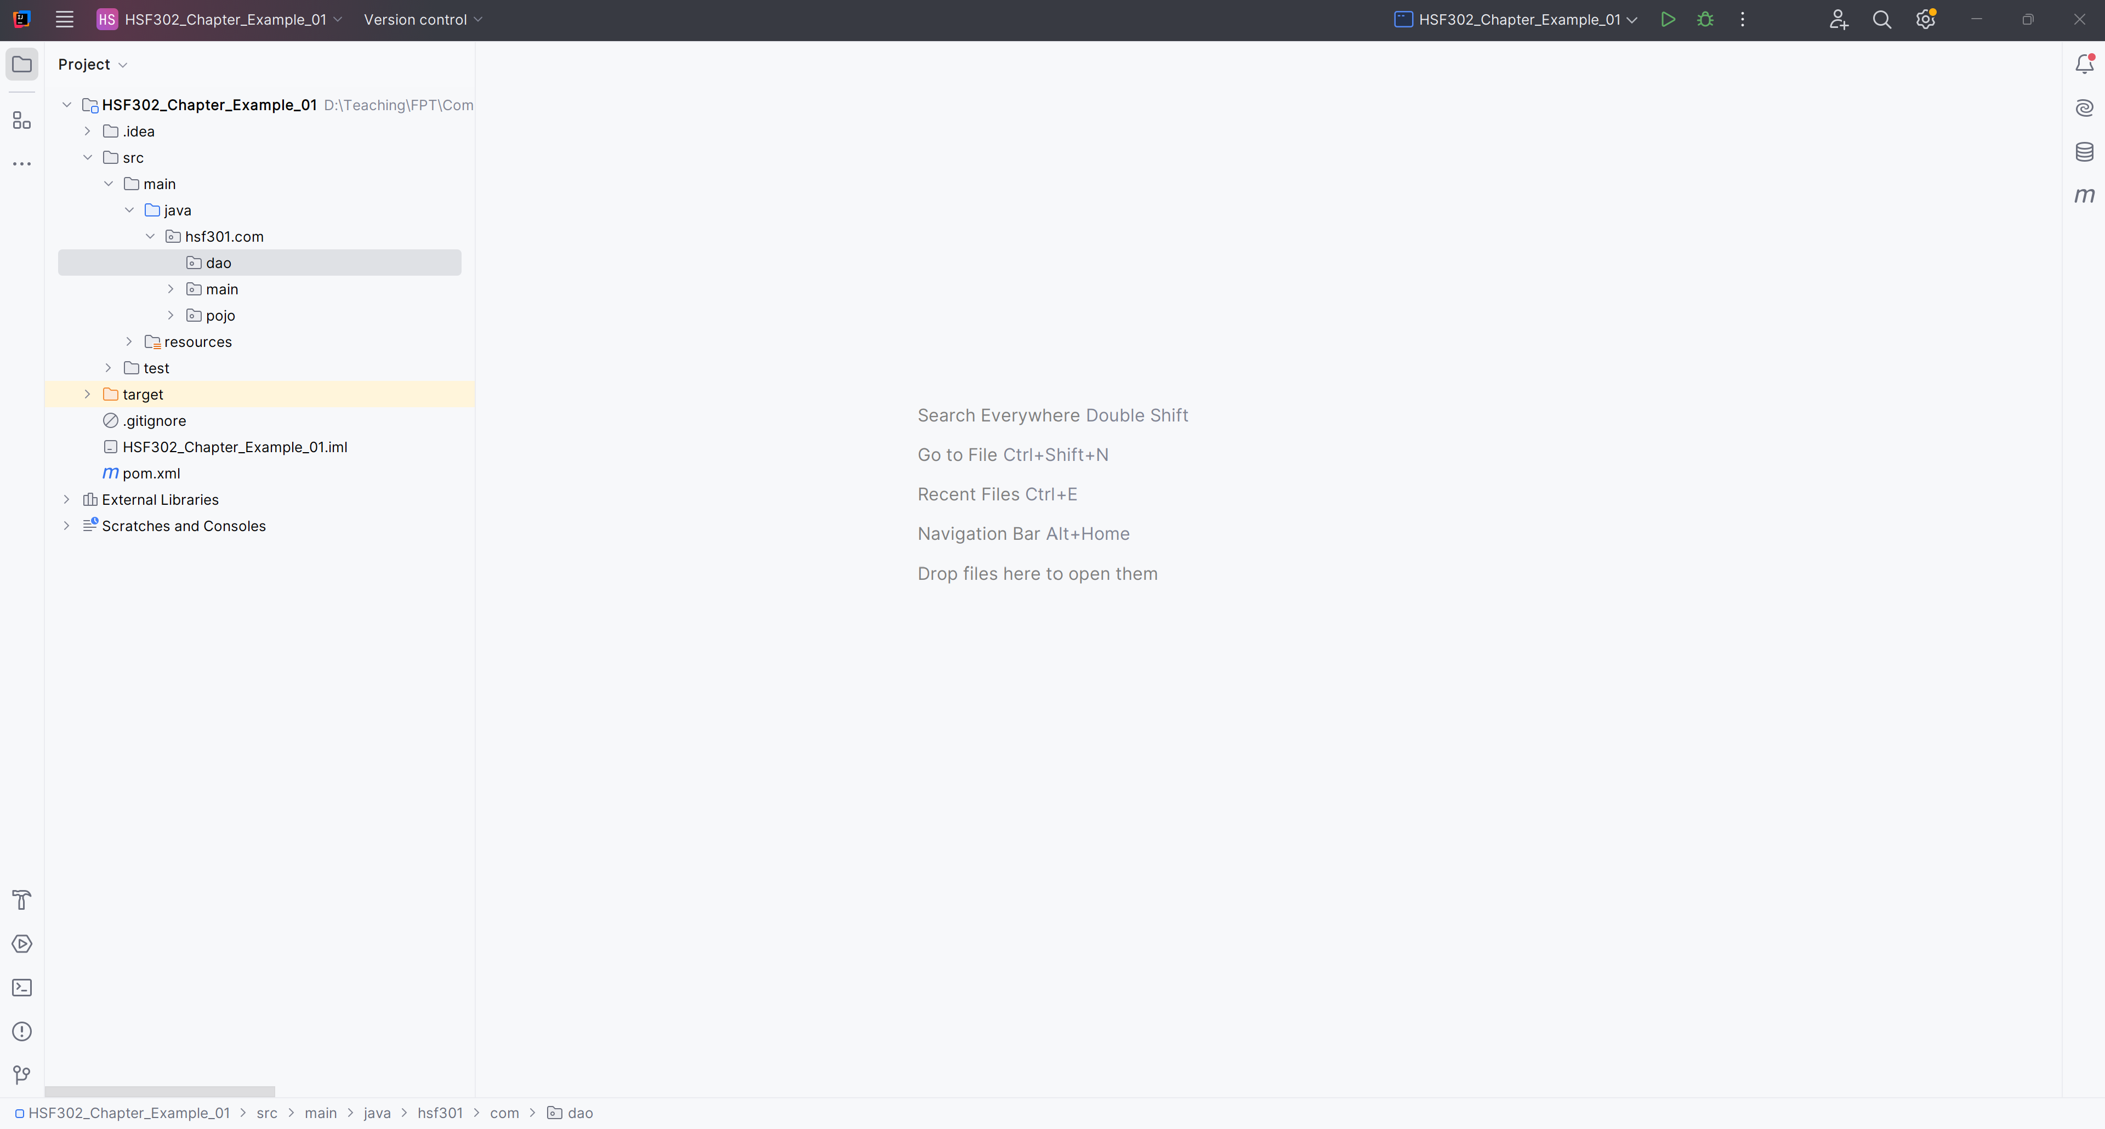
Add hsf301.com.dao Package in src/main/java

Slide 33
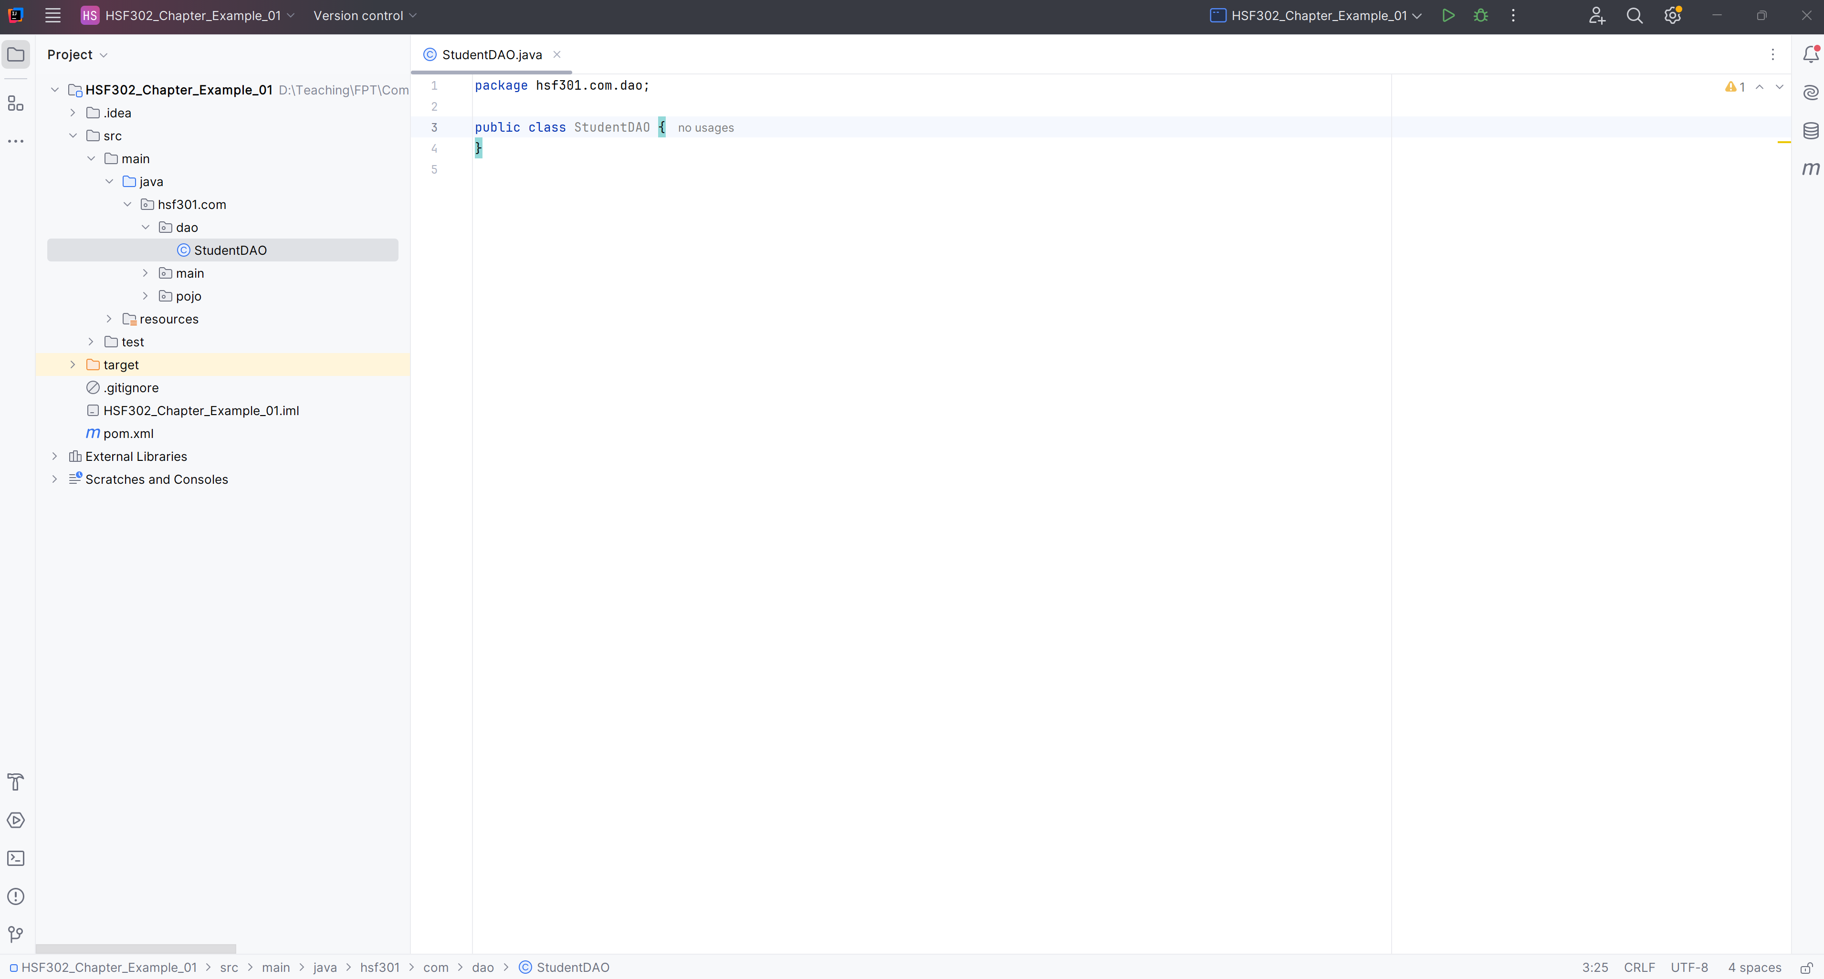
Create StudentDAO in hsf301.com.dao

Slide 34
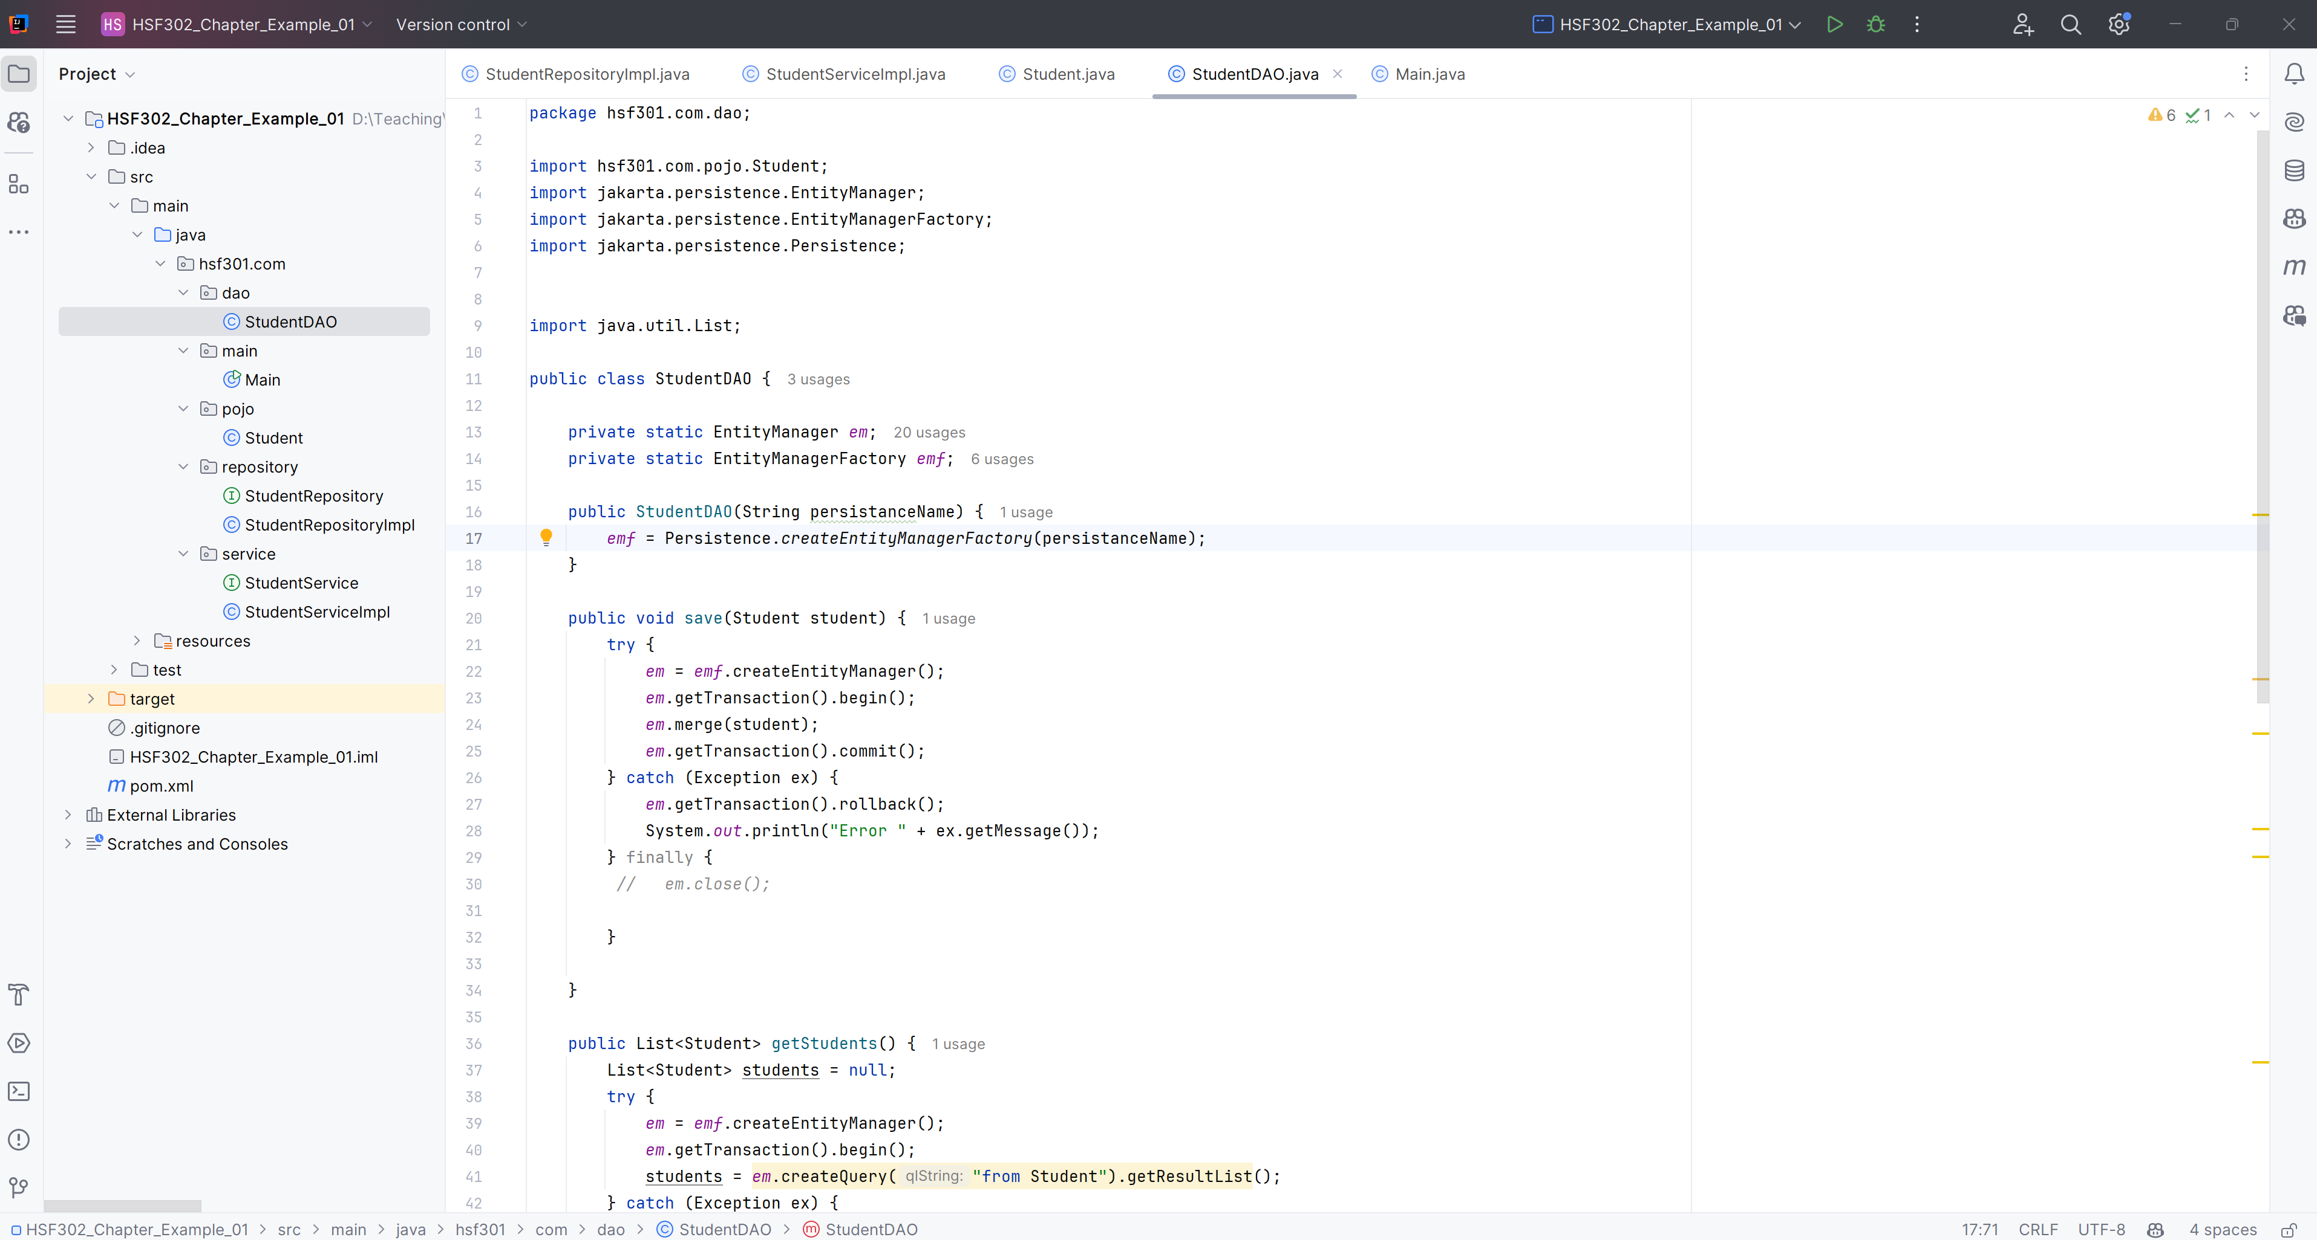
Edit the StudentDAO in hsf301.com.dao

Slide 35
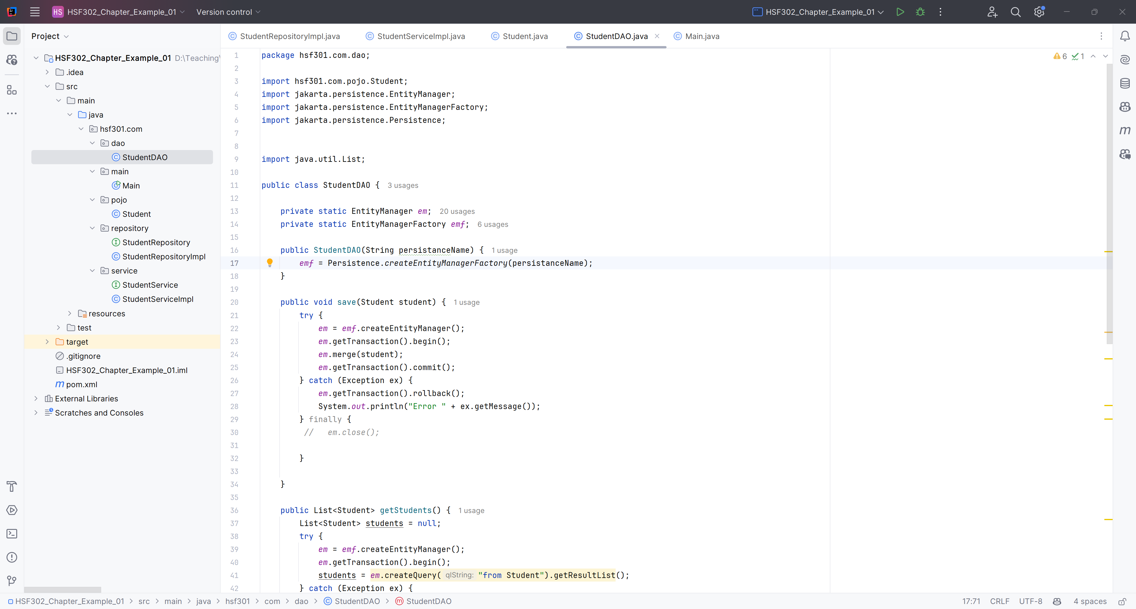
Save Student Method

Slide 36
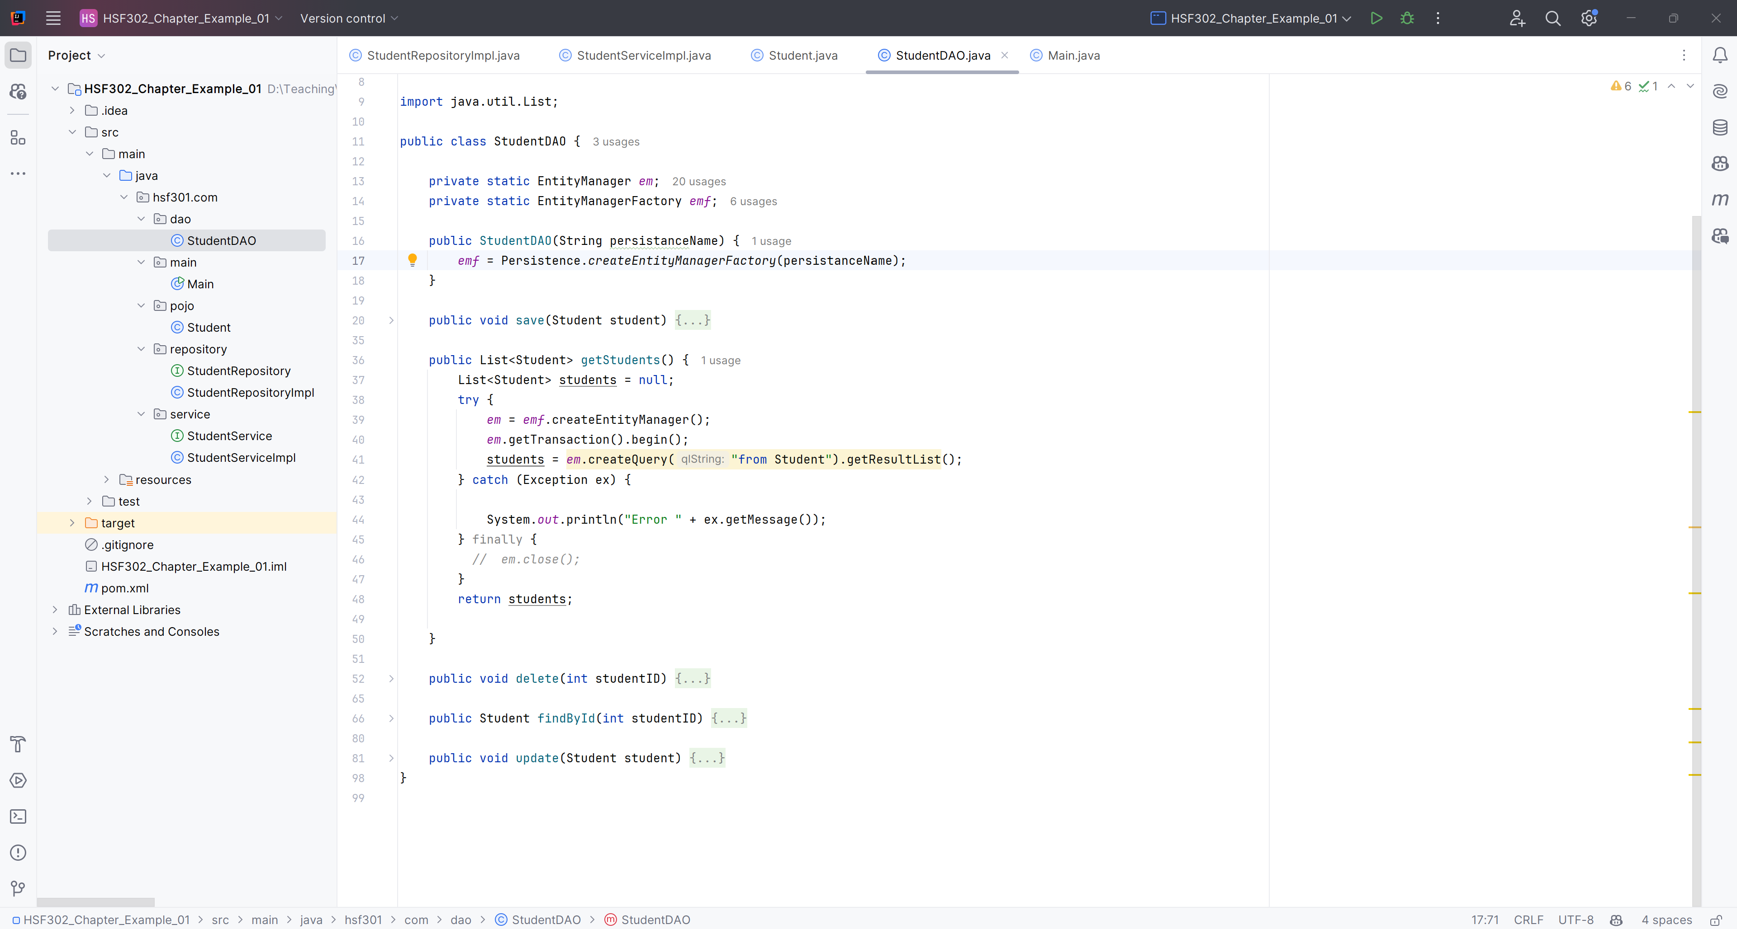
Get All Students Method

Slide 37
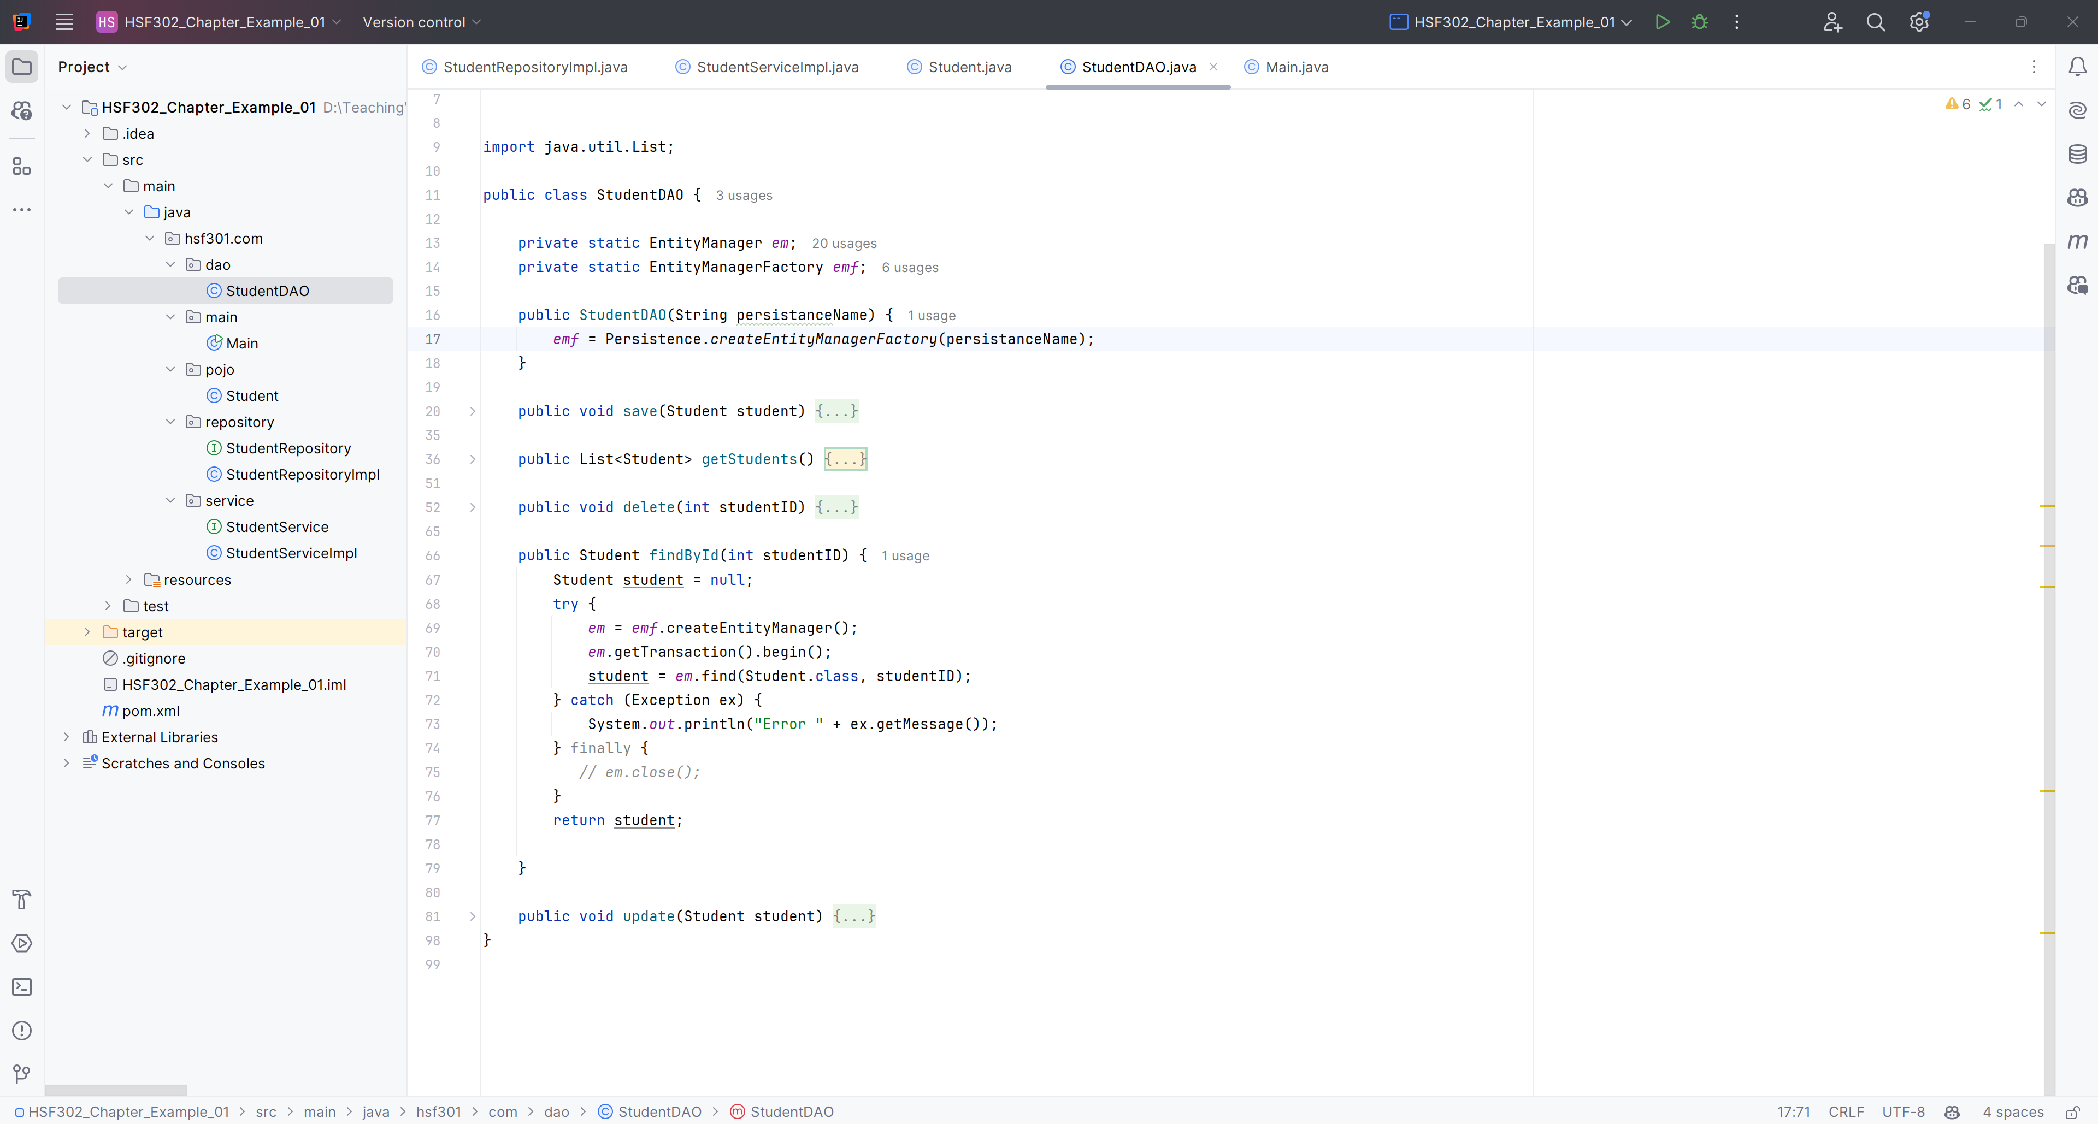
Find a Student Method

Slide 38
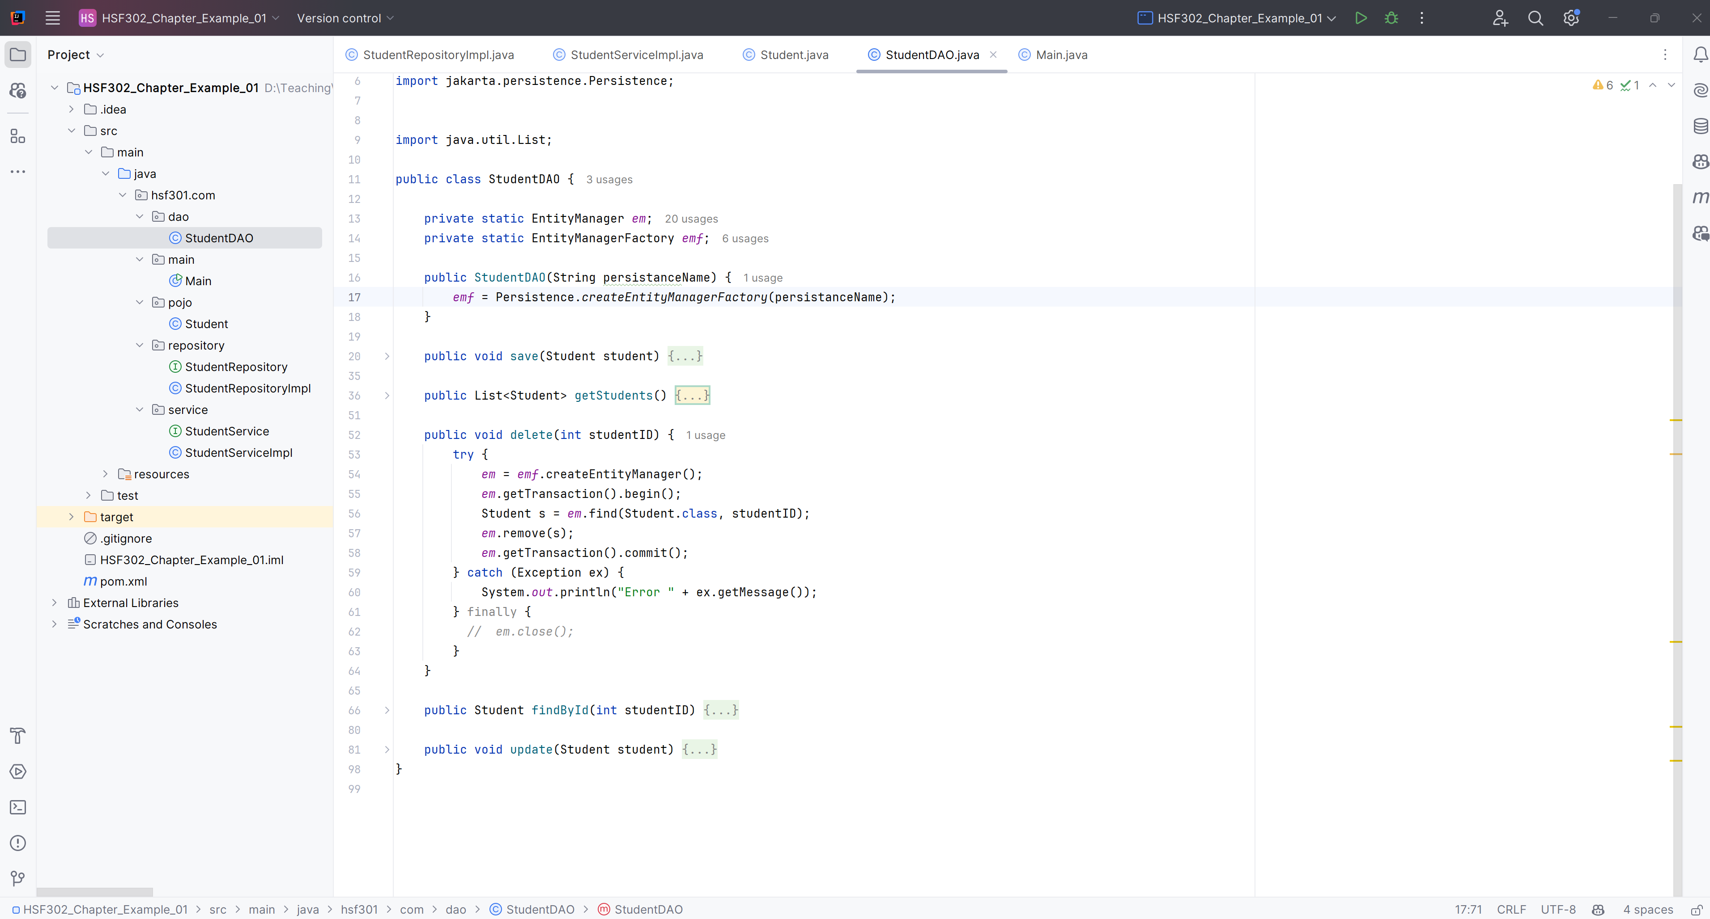
Delete Student Method

Slide 39
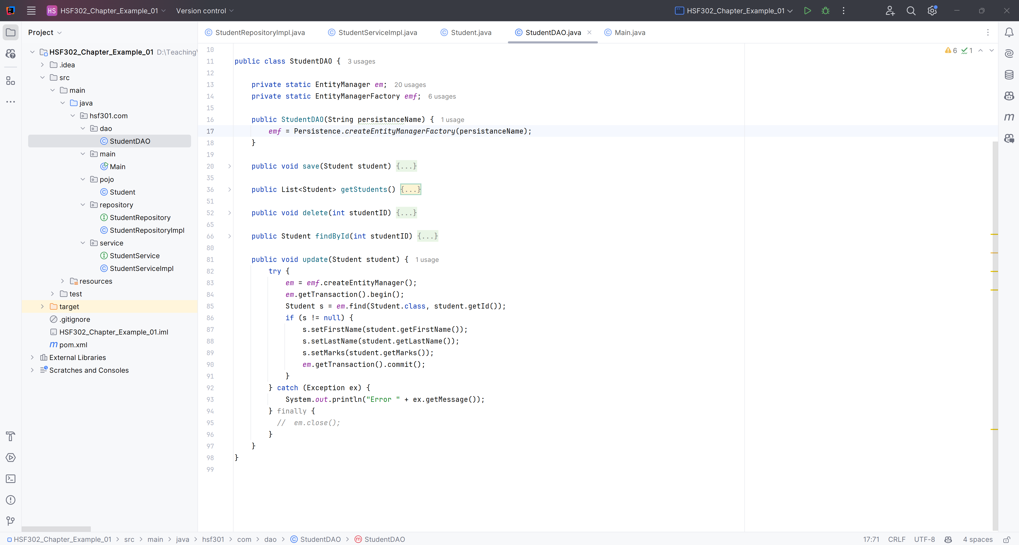
Update Student Method

Slide 40
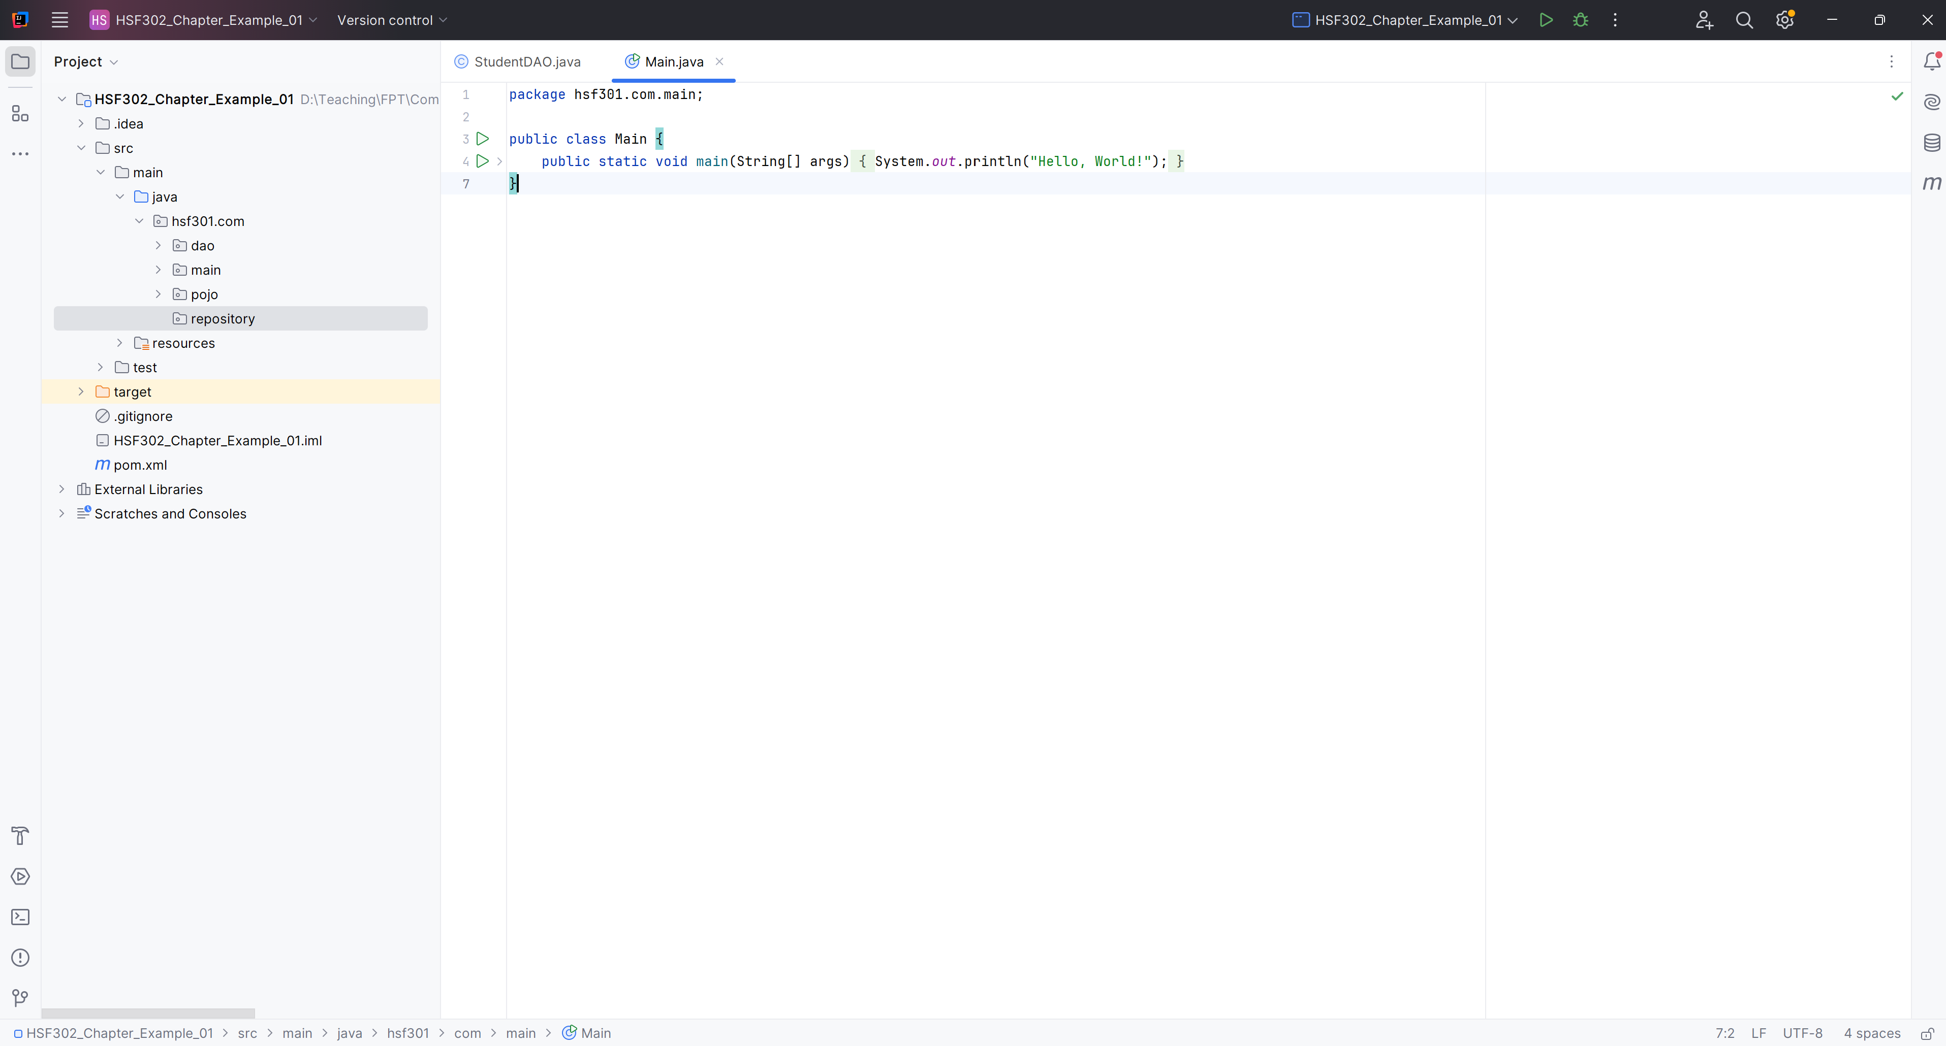
Create hsf301.com.repository Package in src/main/java

Slide 41
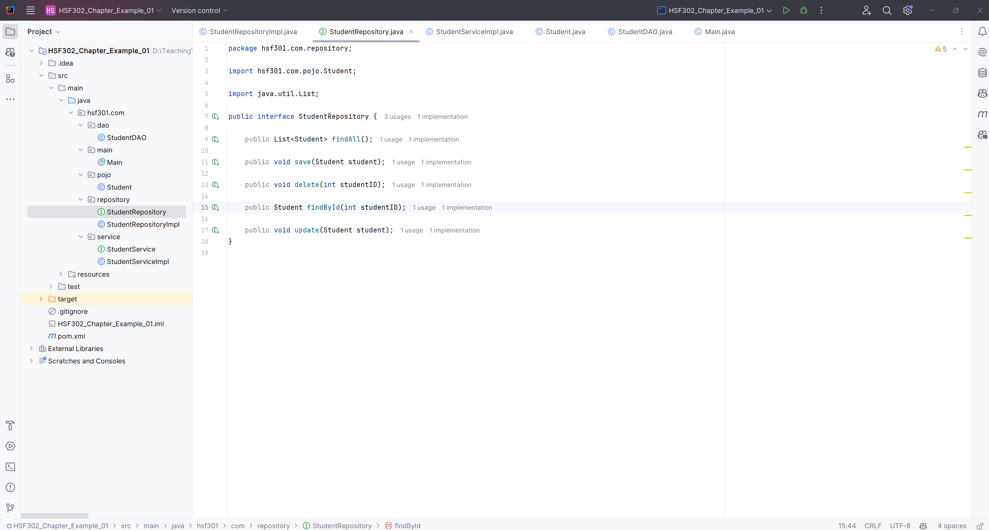
Create StudentRepository

Slide 42
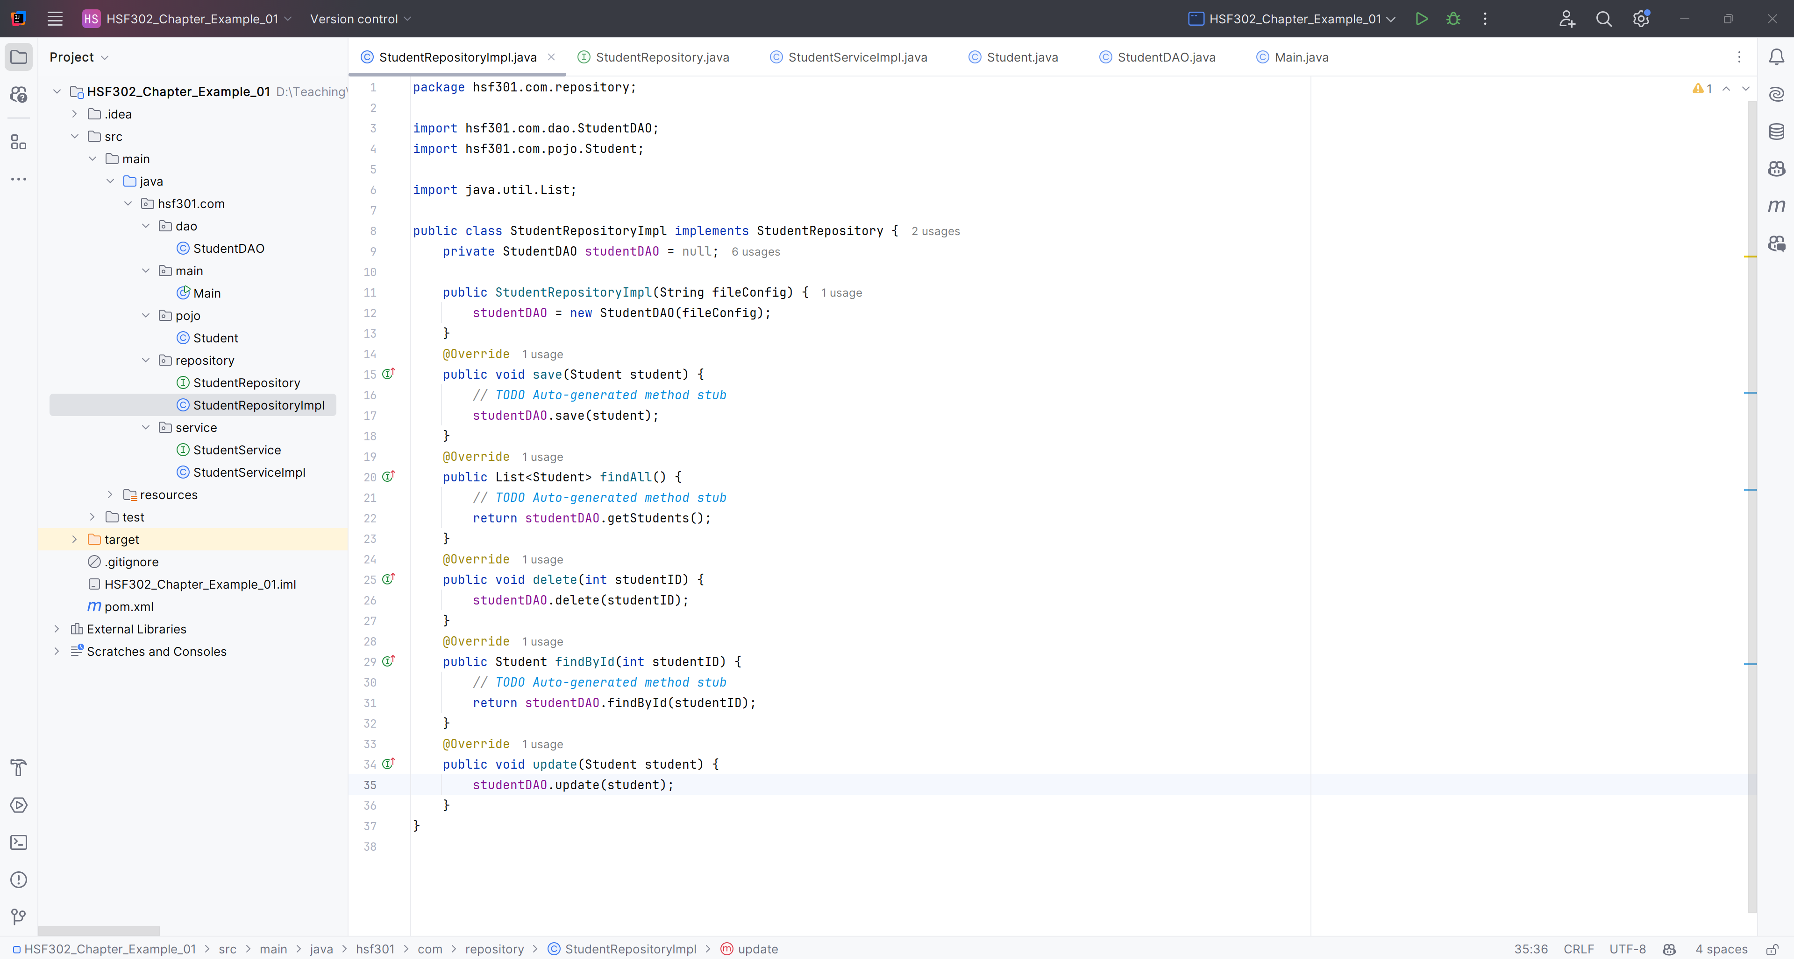
Create StudentRepositoryImpl implement StudentRepository

Slide 43
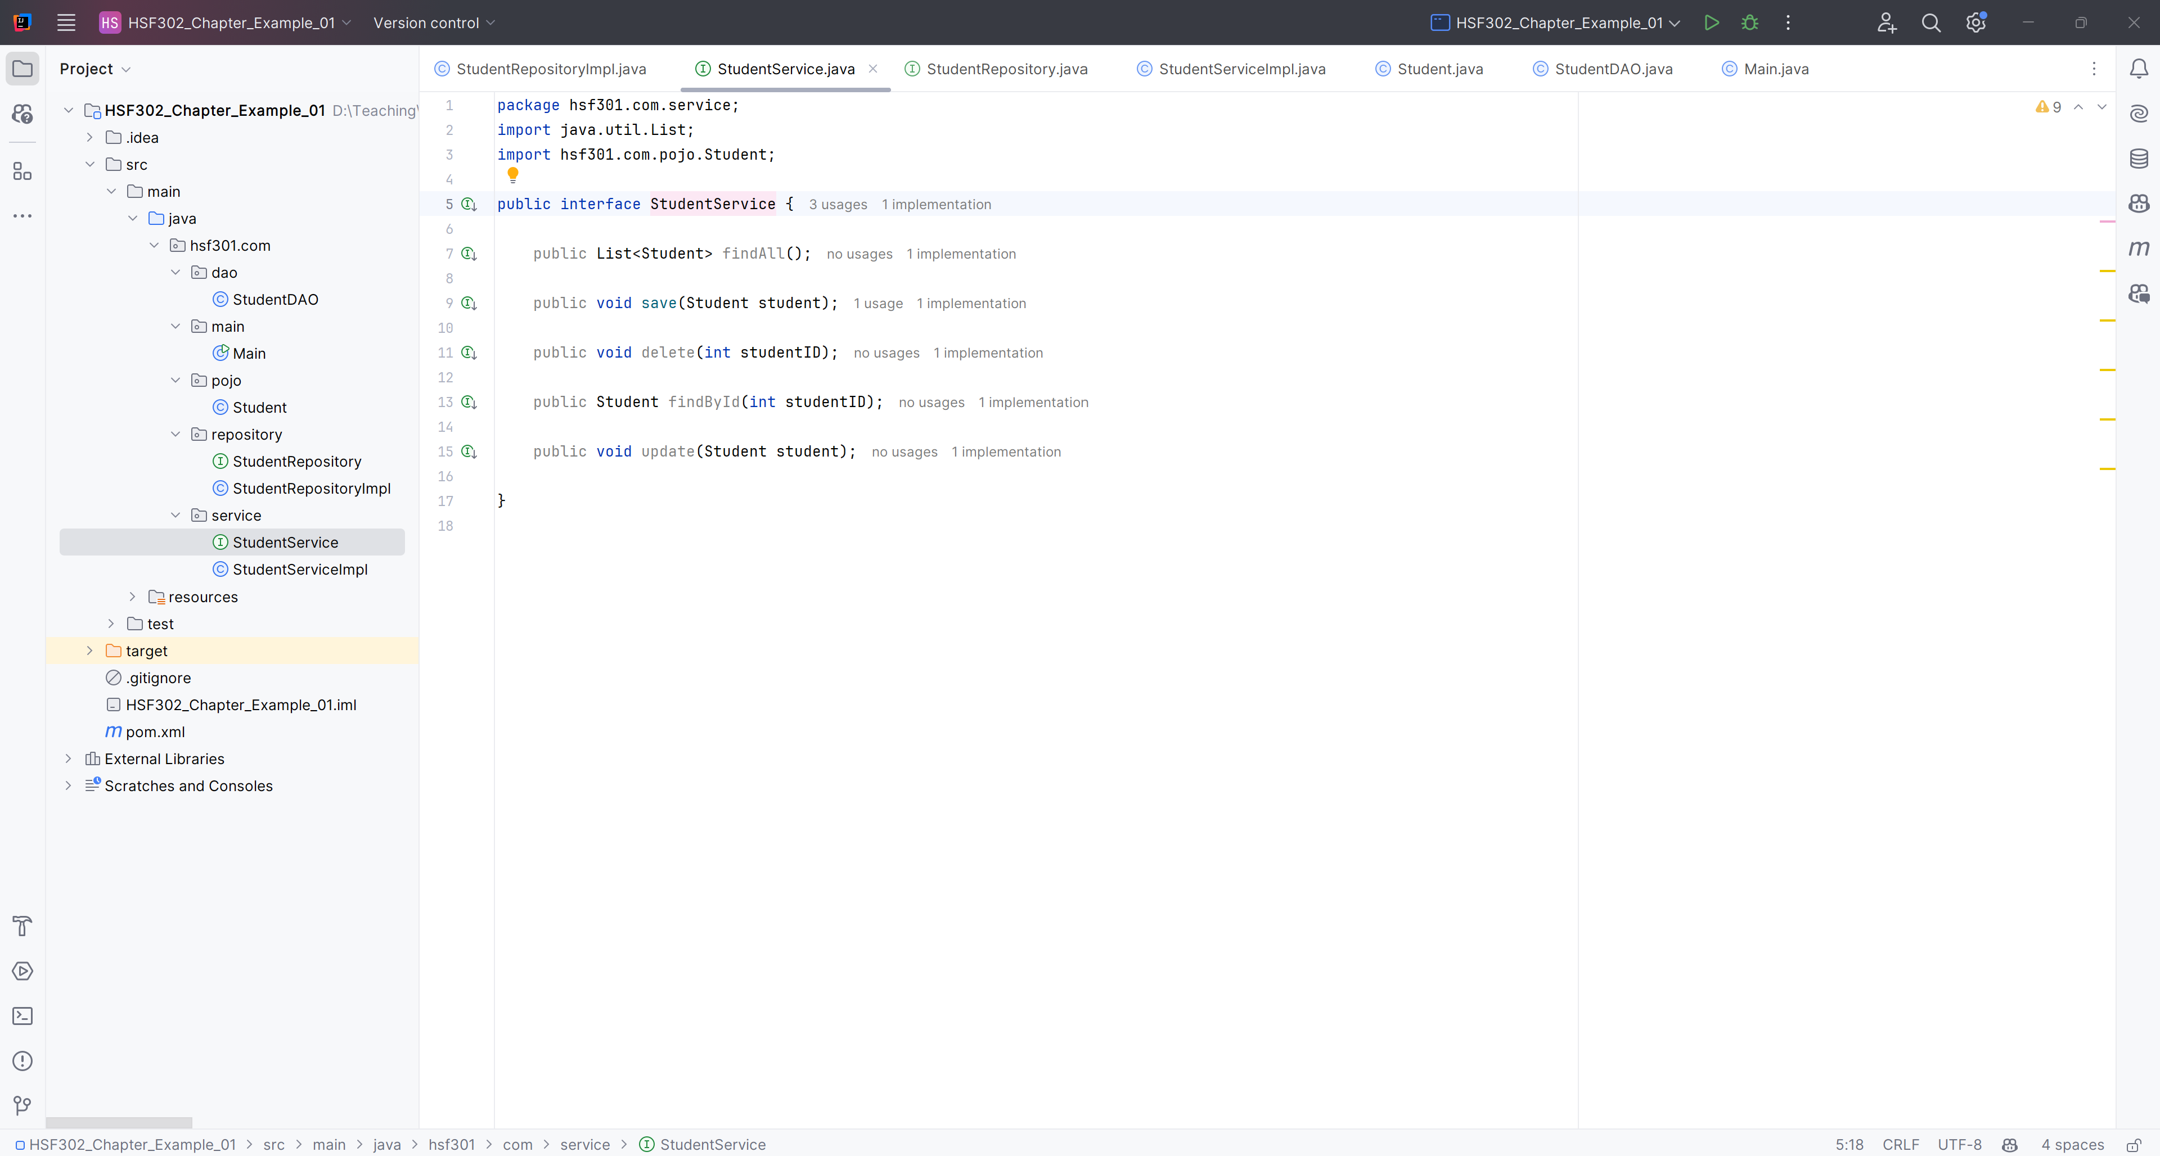
Create StudentService

Slide 44
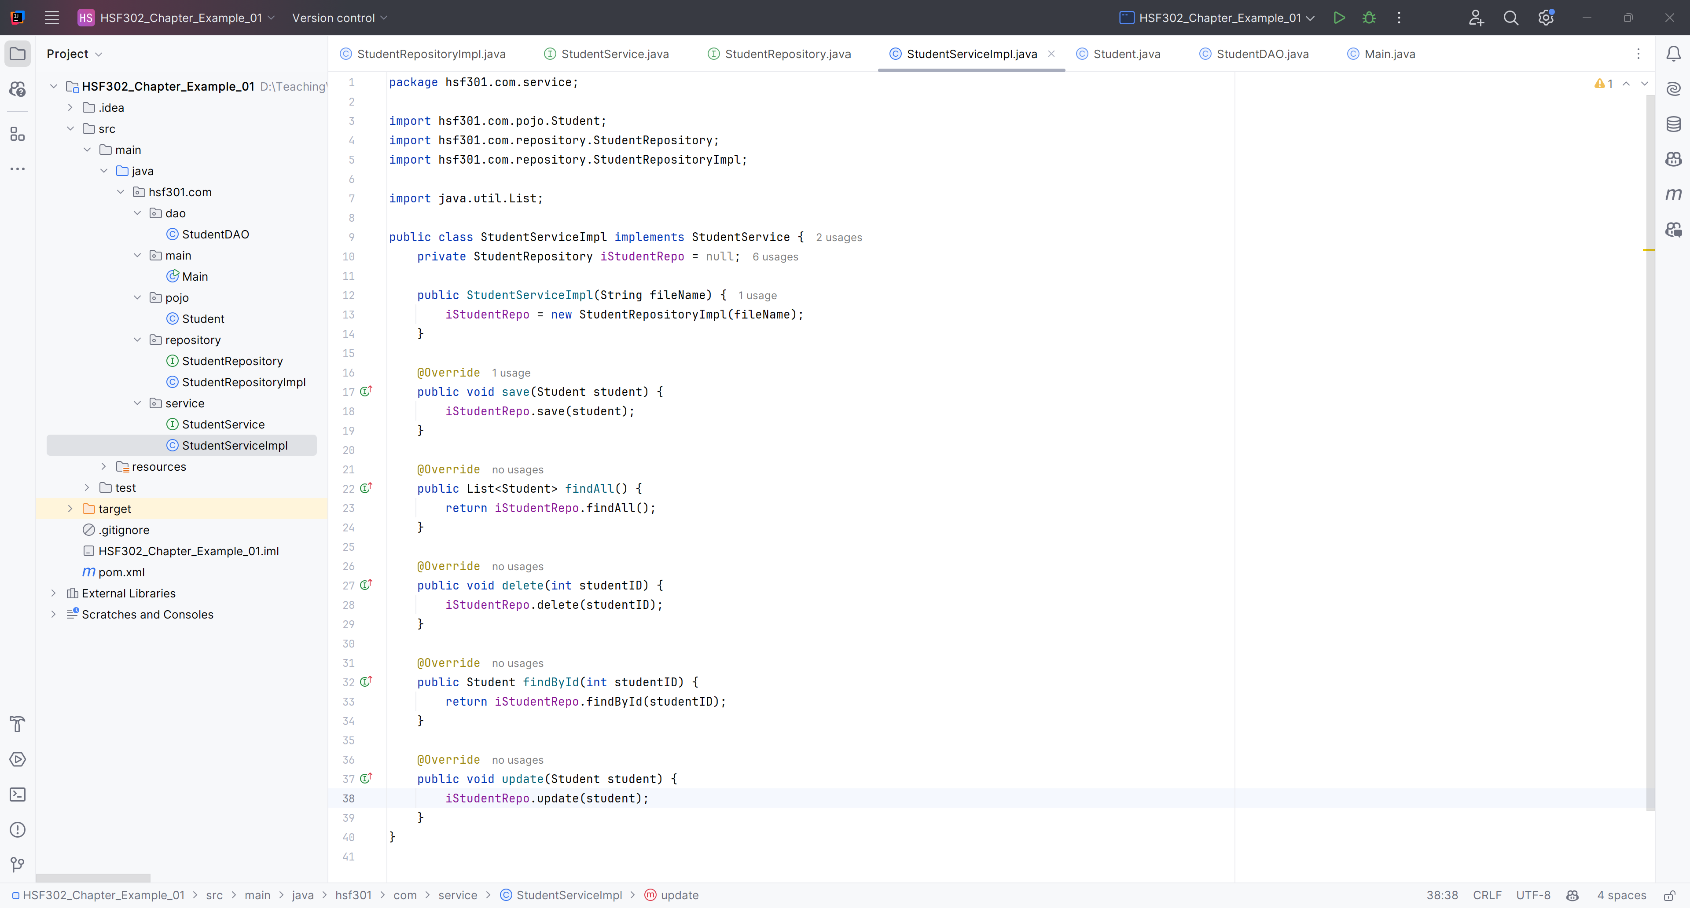
Create StudentServiceImpl implement StudentService

Slide 45
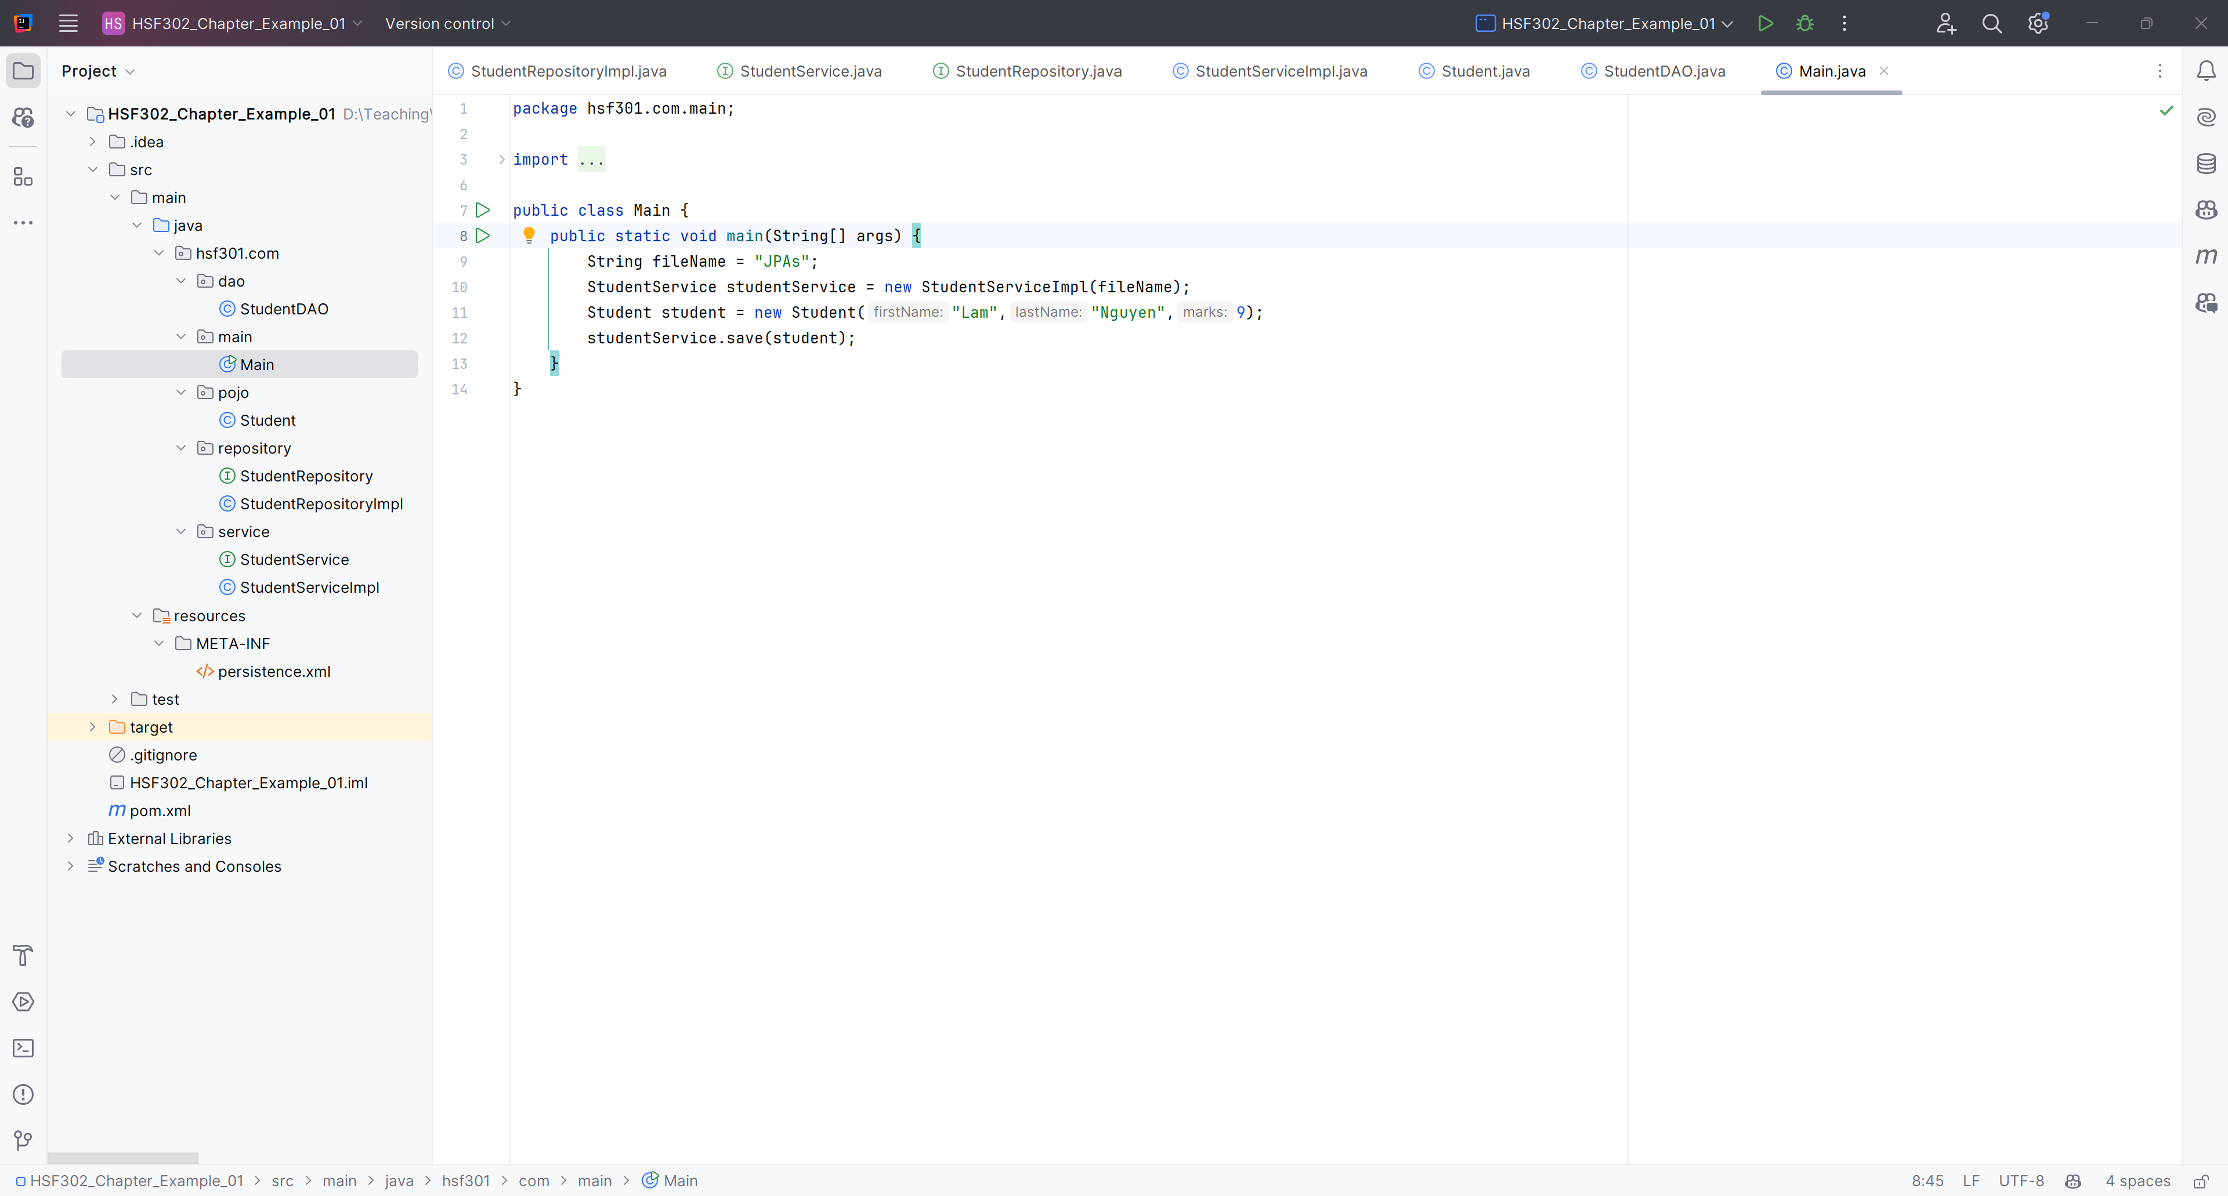
Create Main function

Slide 46
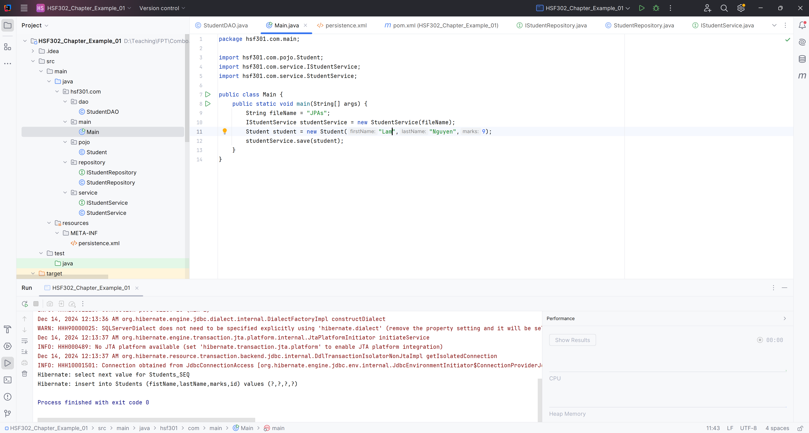
Run Program

Slide 47
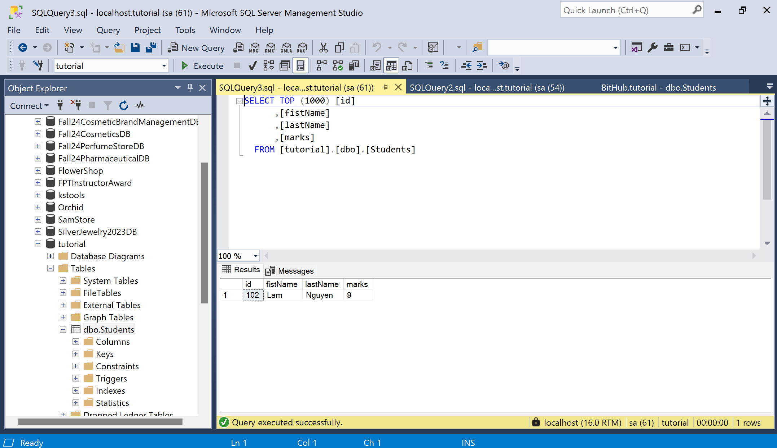
Result

Slide 48
Mapping in JPA

Slide 49
Relationships Annotations in JPA
@ManyToOne: This annotation defines a many-to-one relationship between two entities.
@OneToMany: This annotation defines a one-to-many relationship between two entities.
@OneToOne: This annotation defines a one-to-one relationship between two entities.
@ManyToMany: This annotation defines a many-to-many relationship between two entities.

Slide 50
Demo JPA (One To Many)

Slide 51
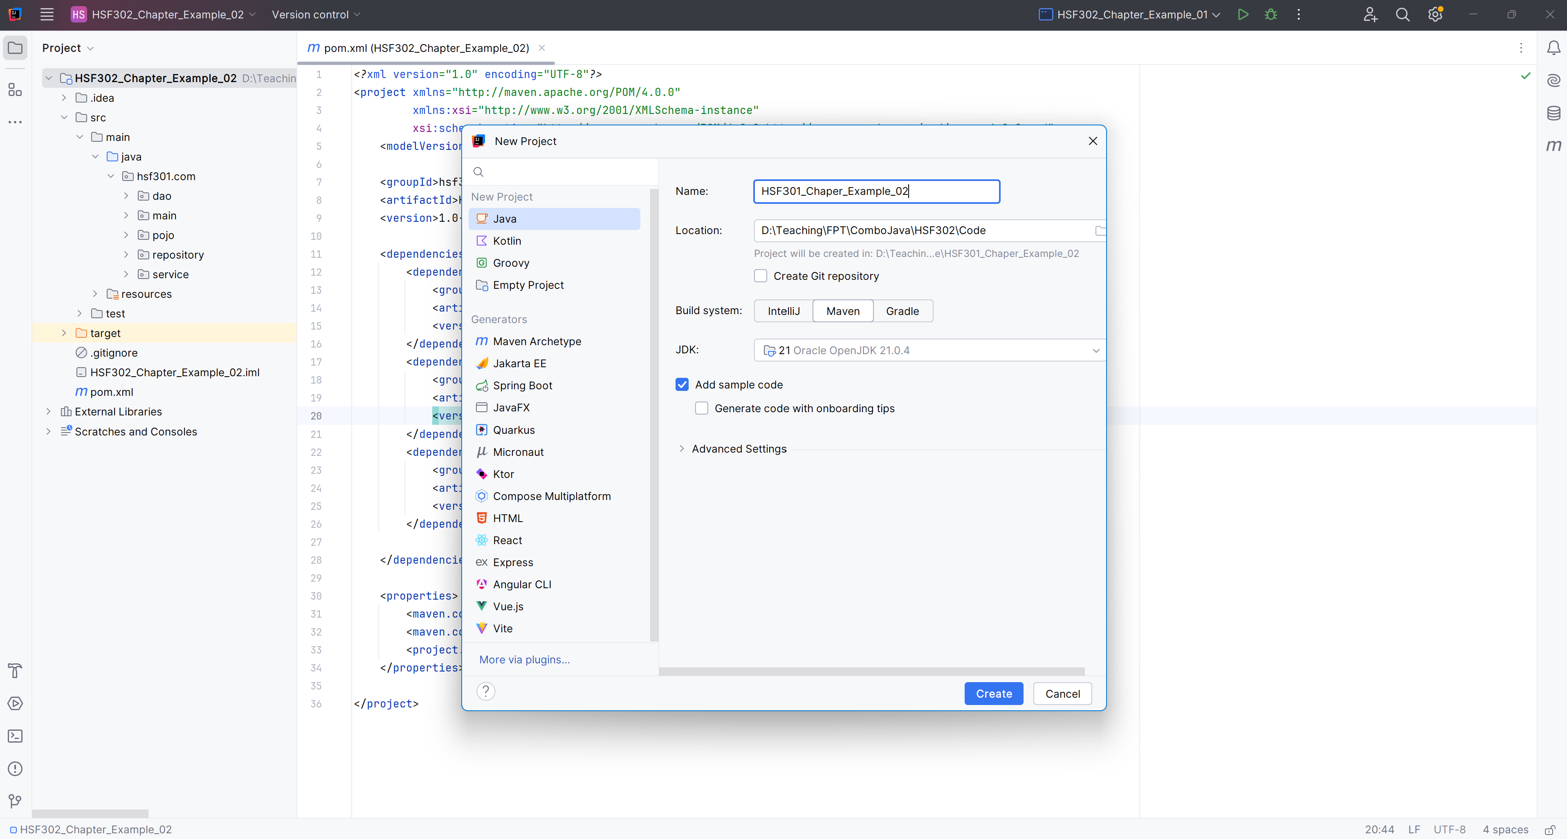
Open IntelliJ, File | New | Maven Project

Slide 52
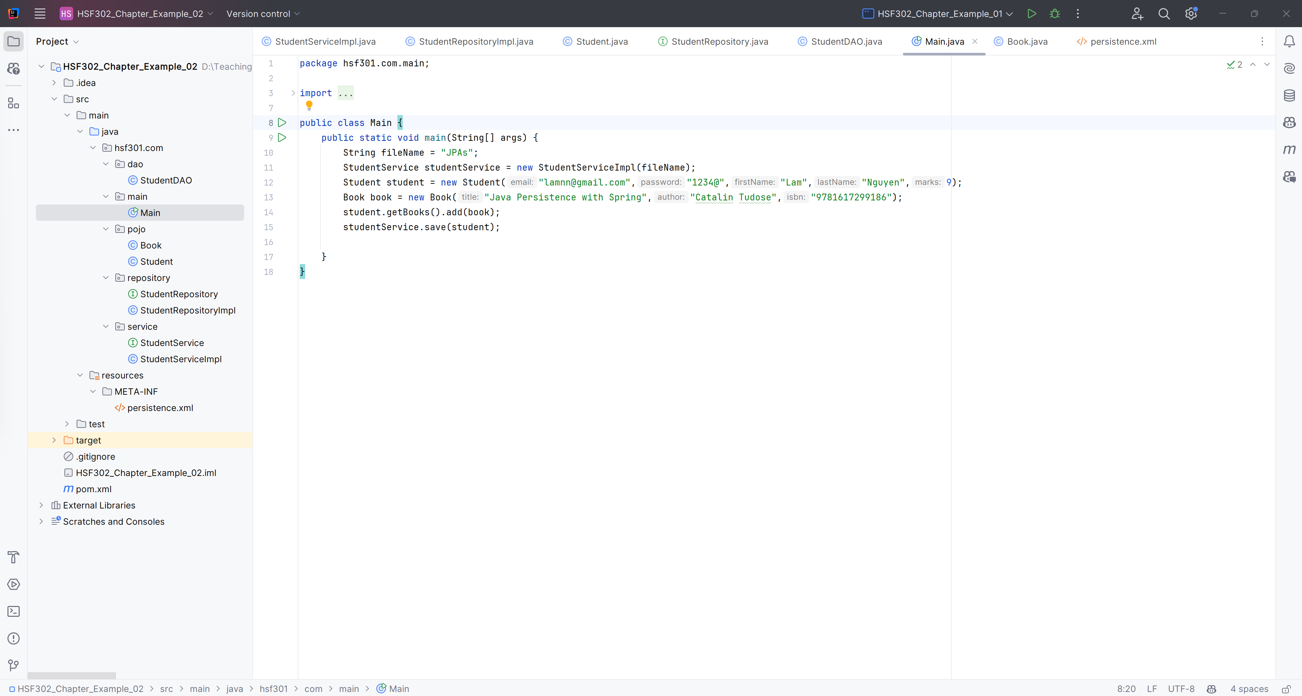
Create a structure of Maven Project
1

Slide 53
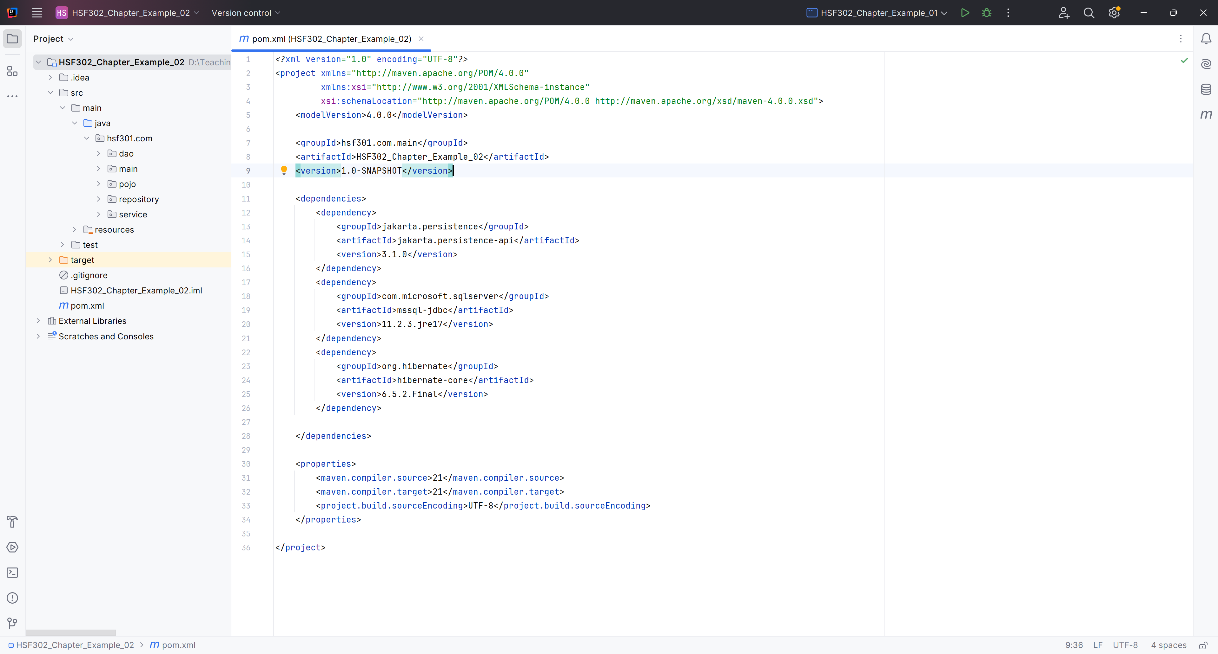
Edit pom.xml
1

Slide 54
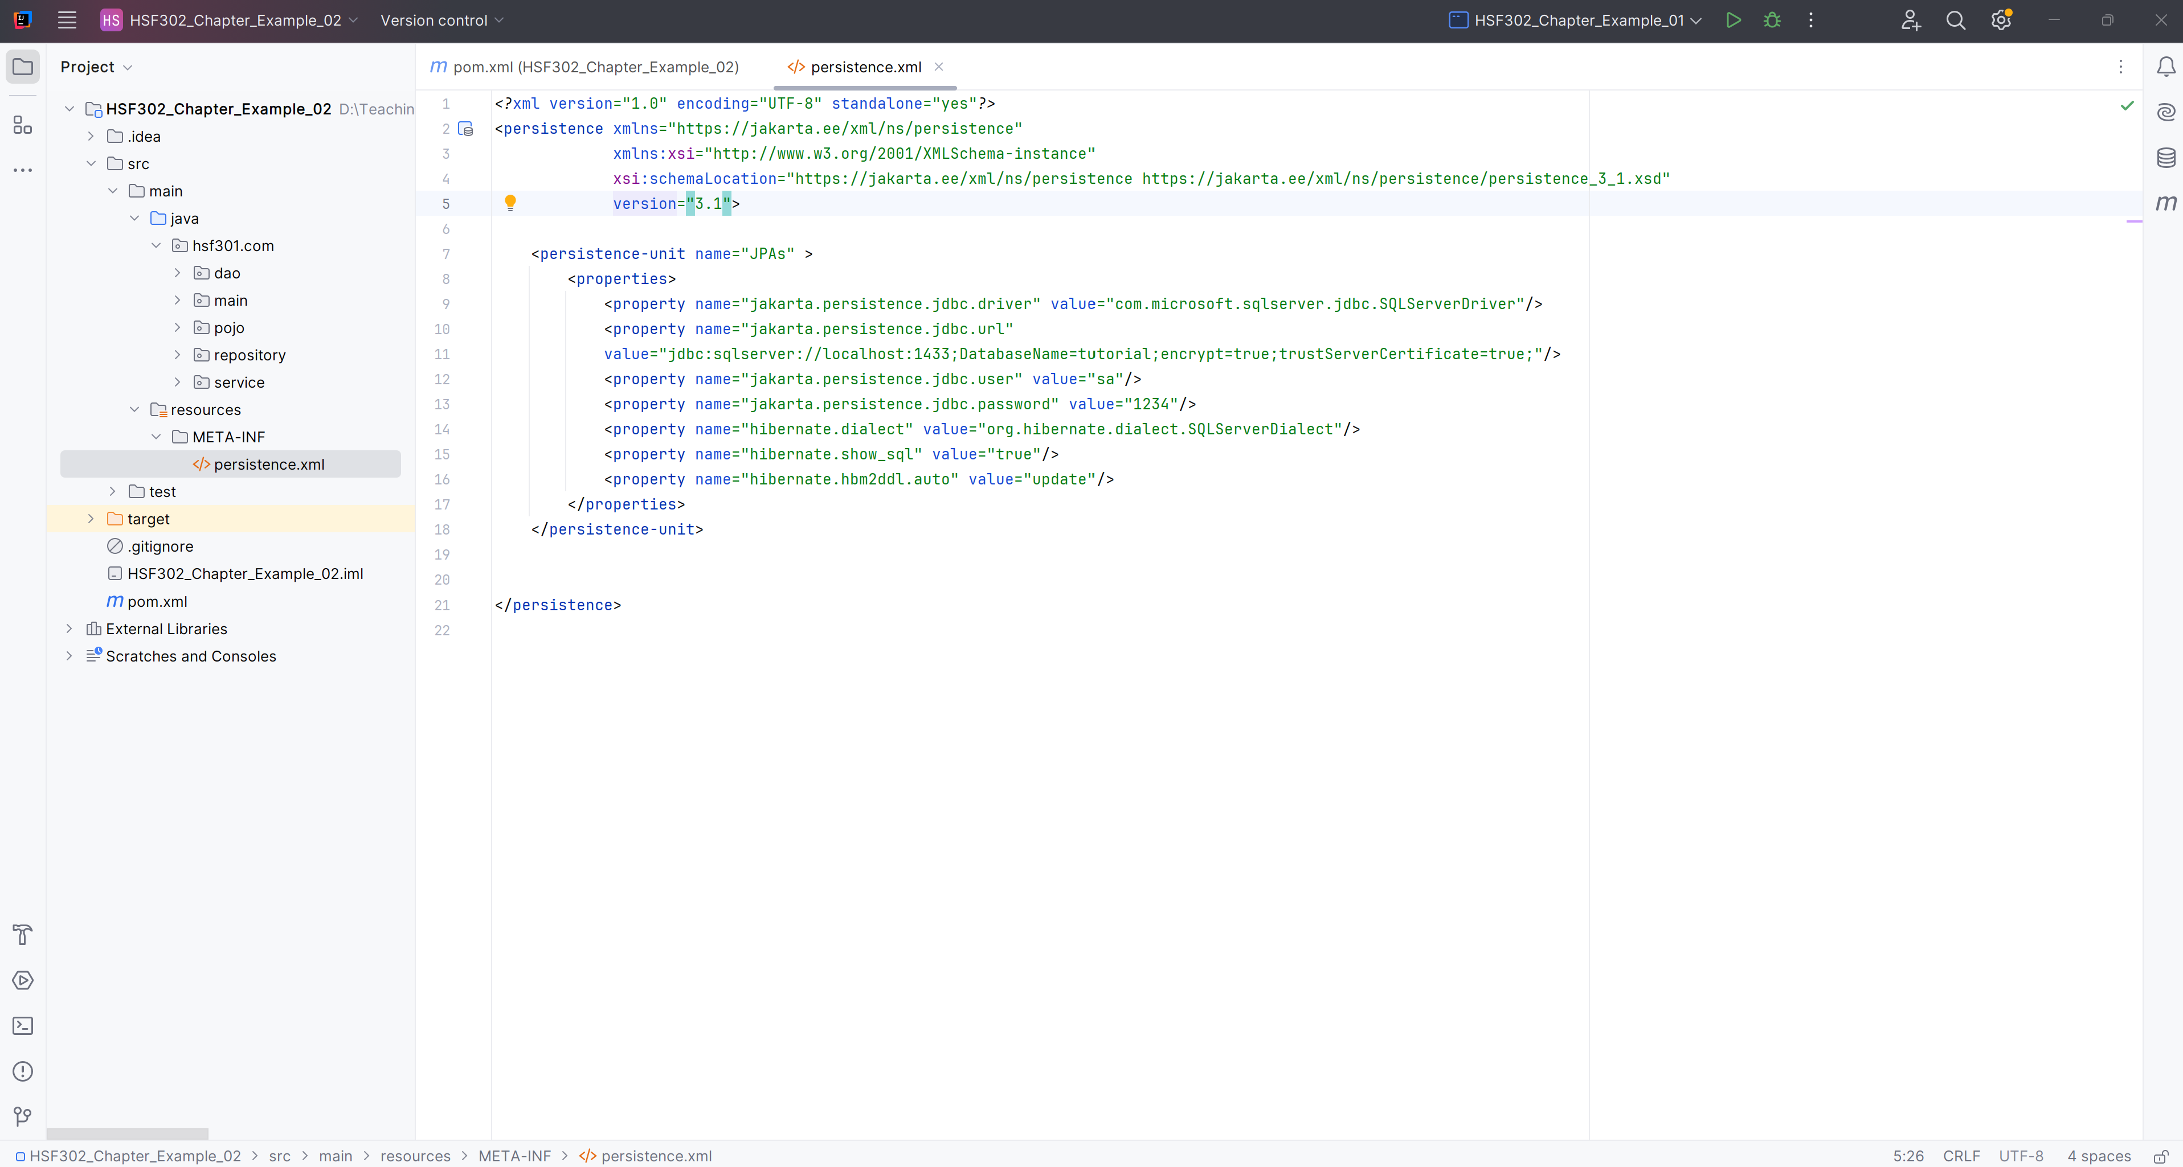
Create persistence.xml in META-INF folder

Slide 55
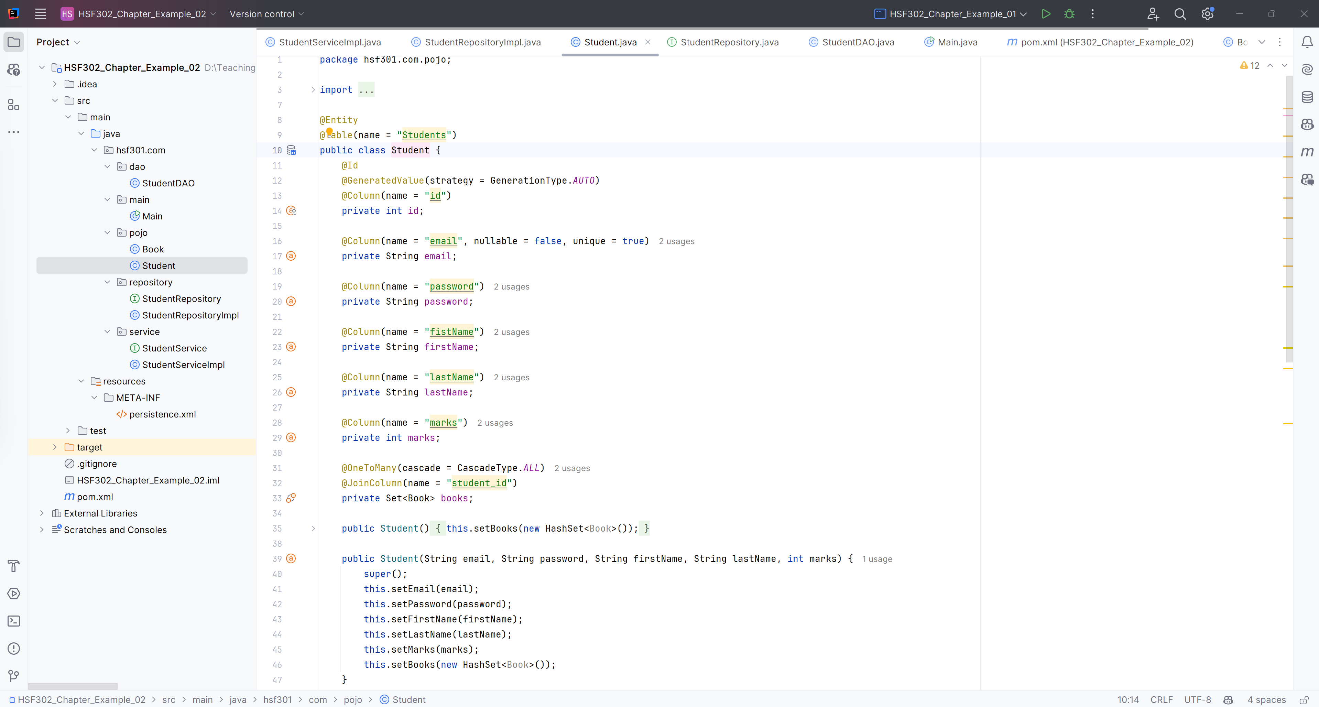
Create Student.java in Pojo

Slide 56
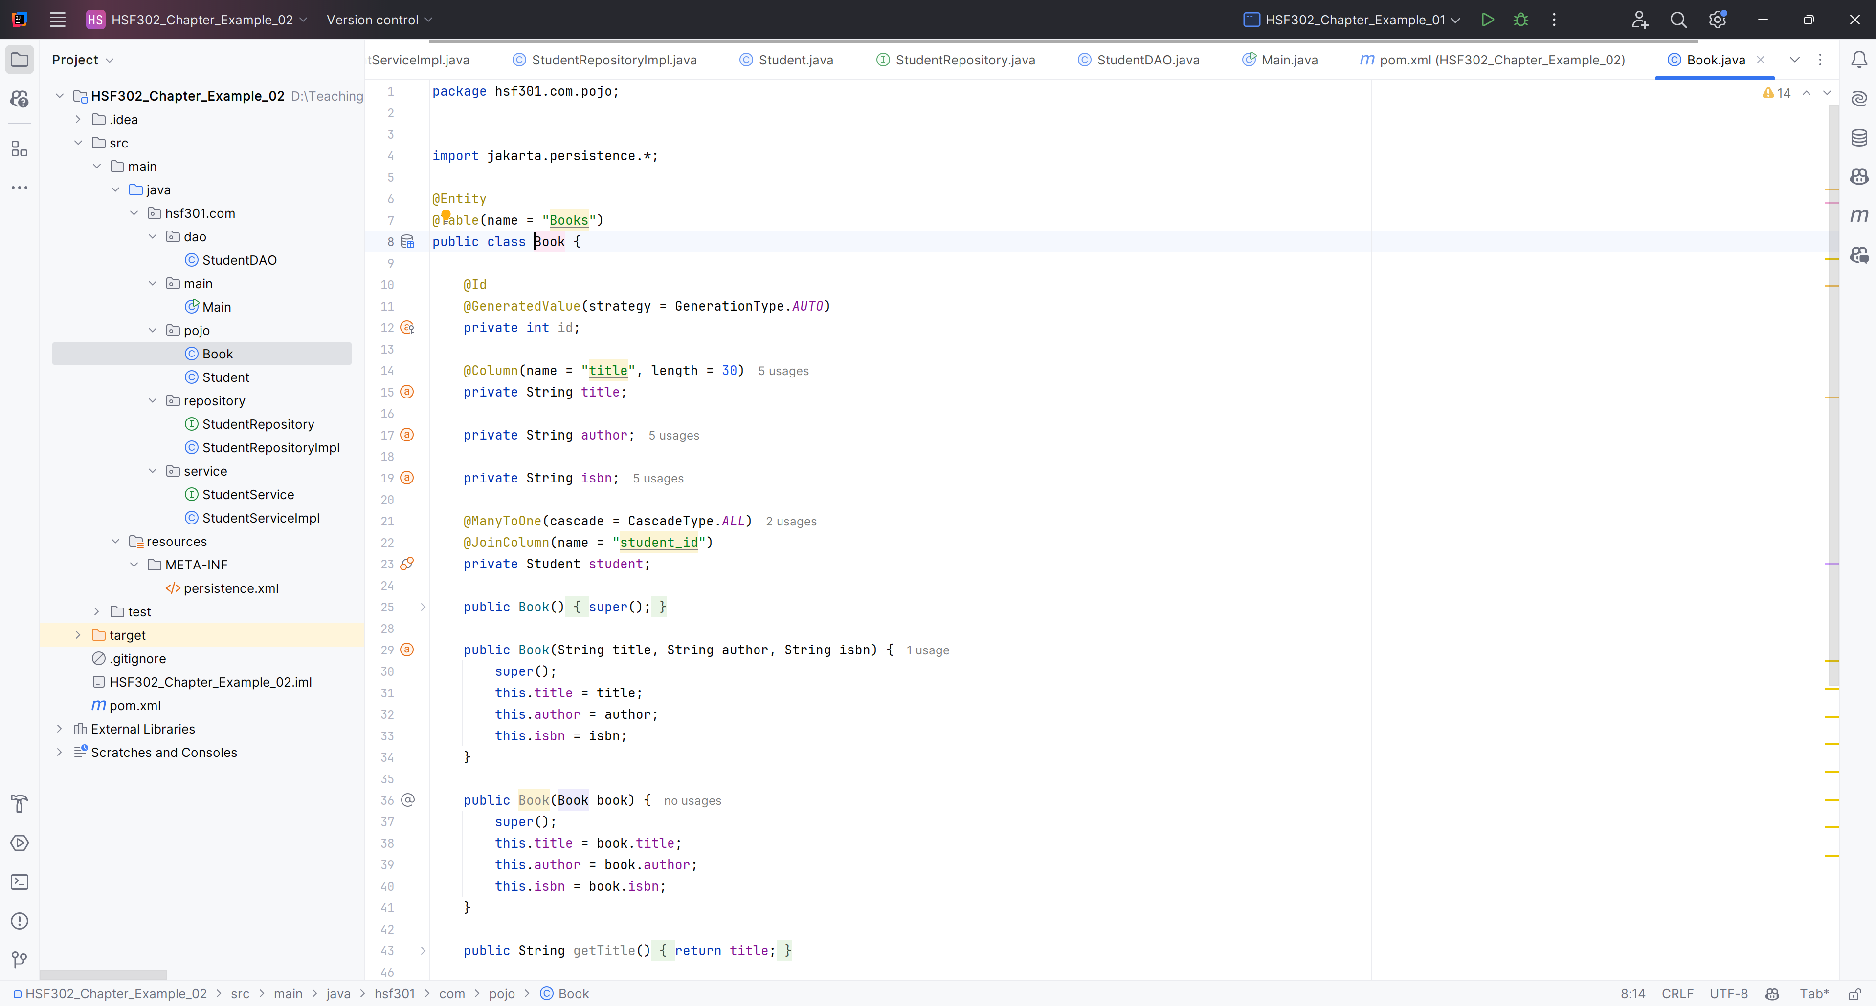
Create Book.java in hsf301.com.pojo

Slide 57
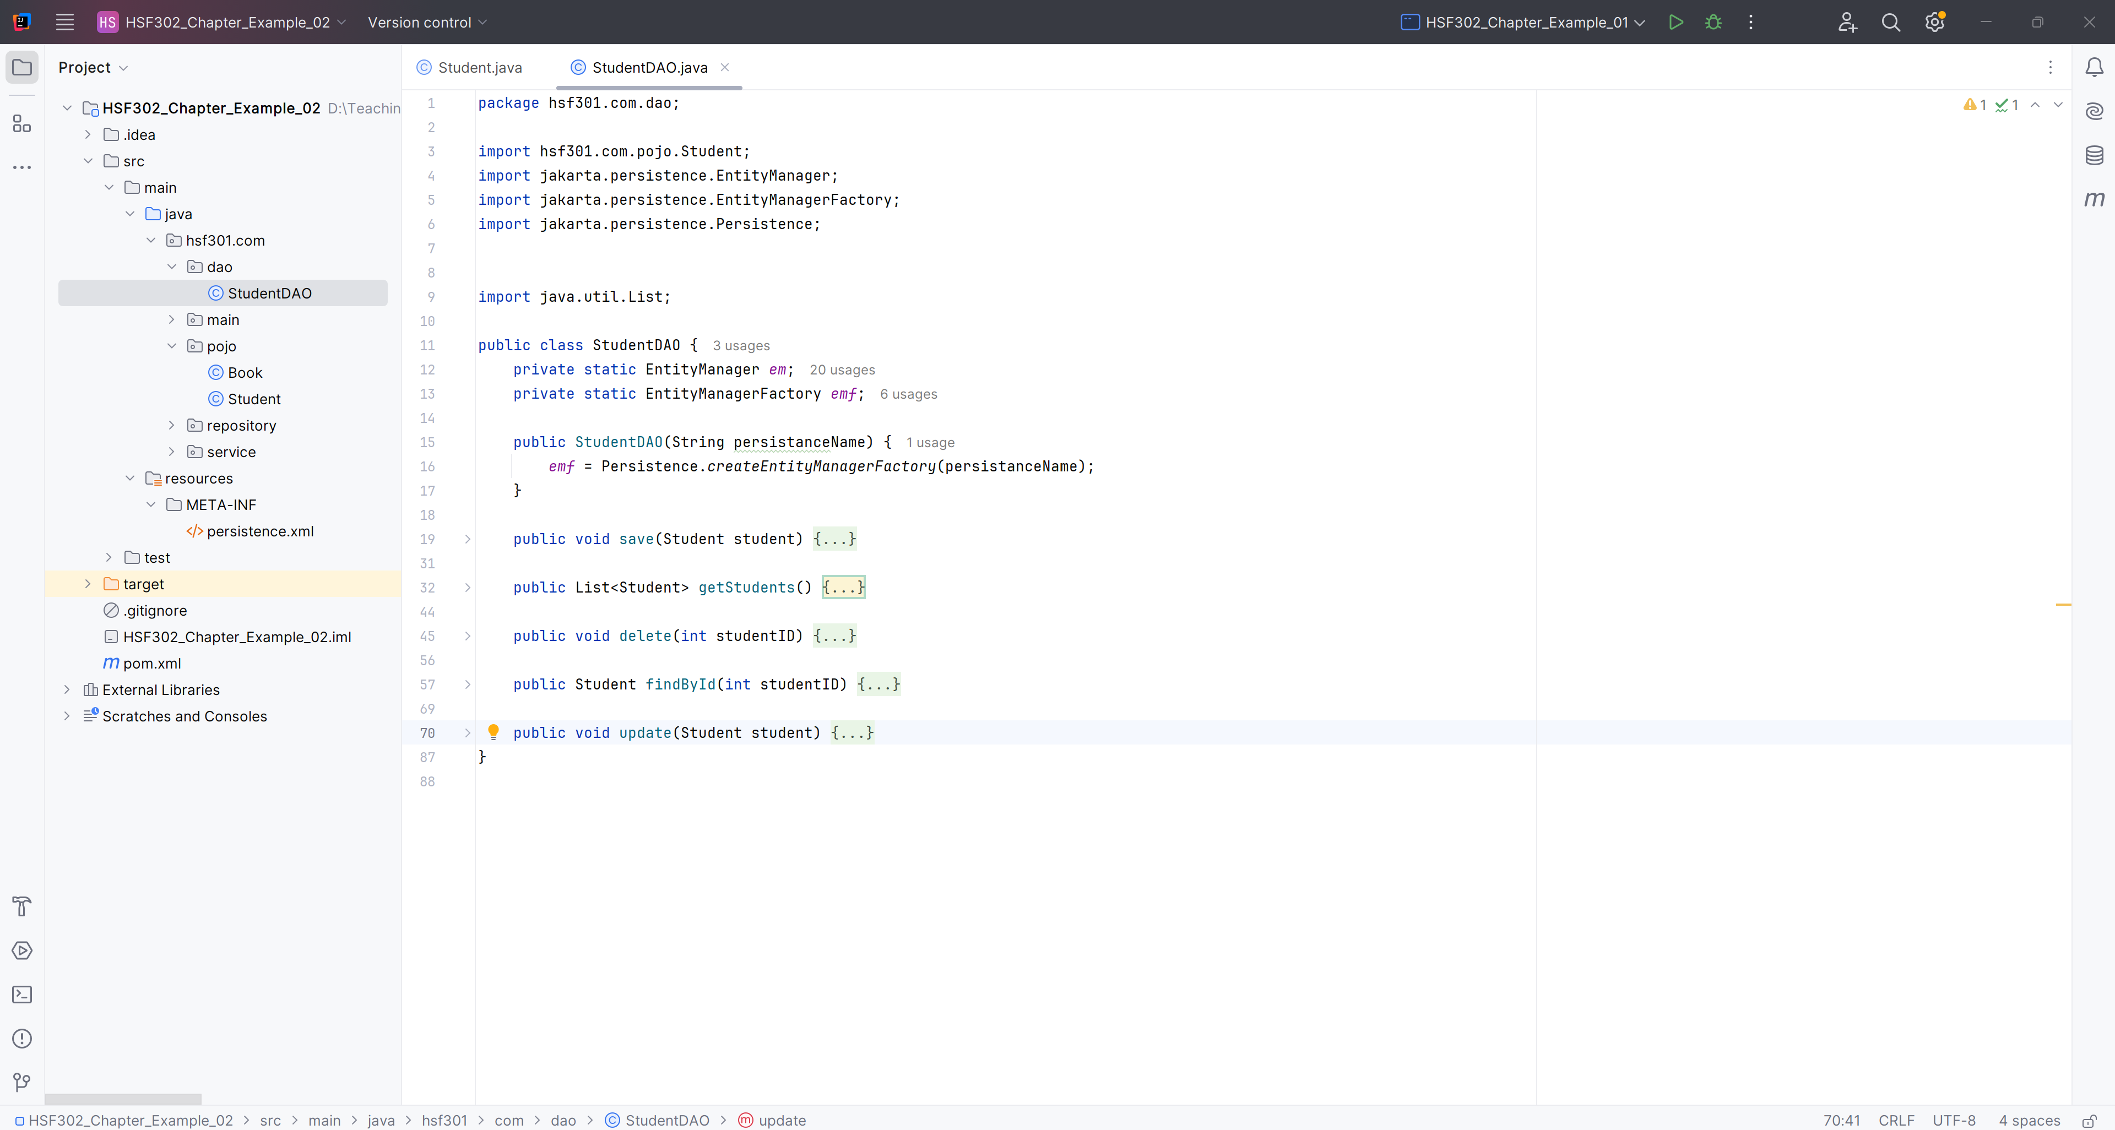
Create StudentDAO

Slide 58
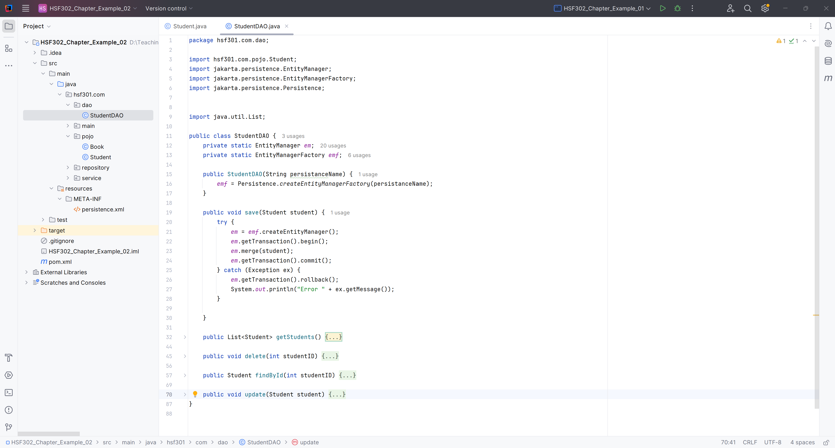
Save Student in StudentDAO

Slide 59
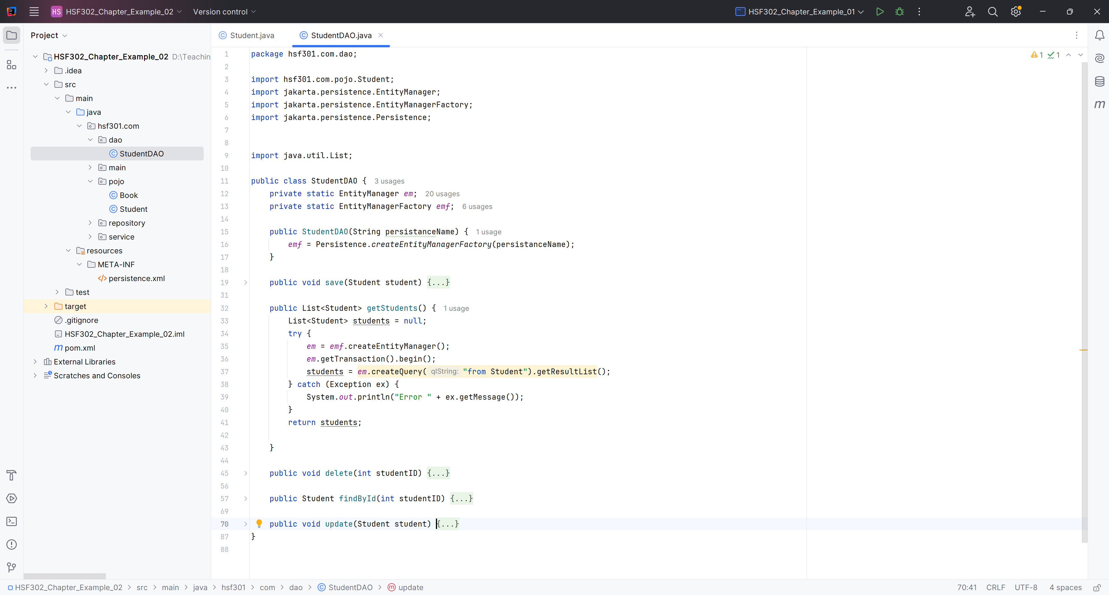
Get All Students in StudentDAO

Slide 60
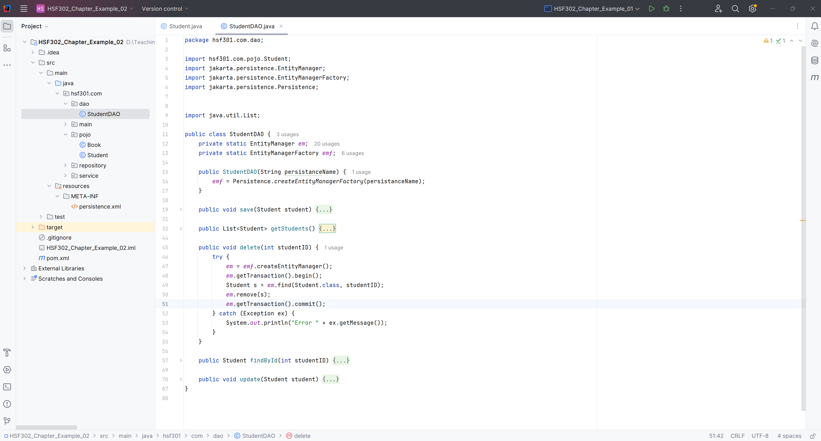
Delete Student in StudentDAO

Slide 61
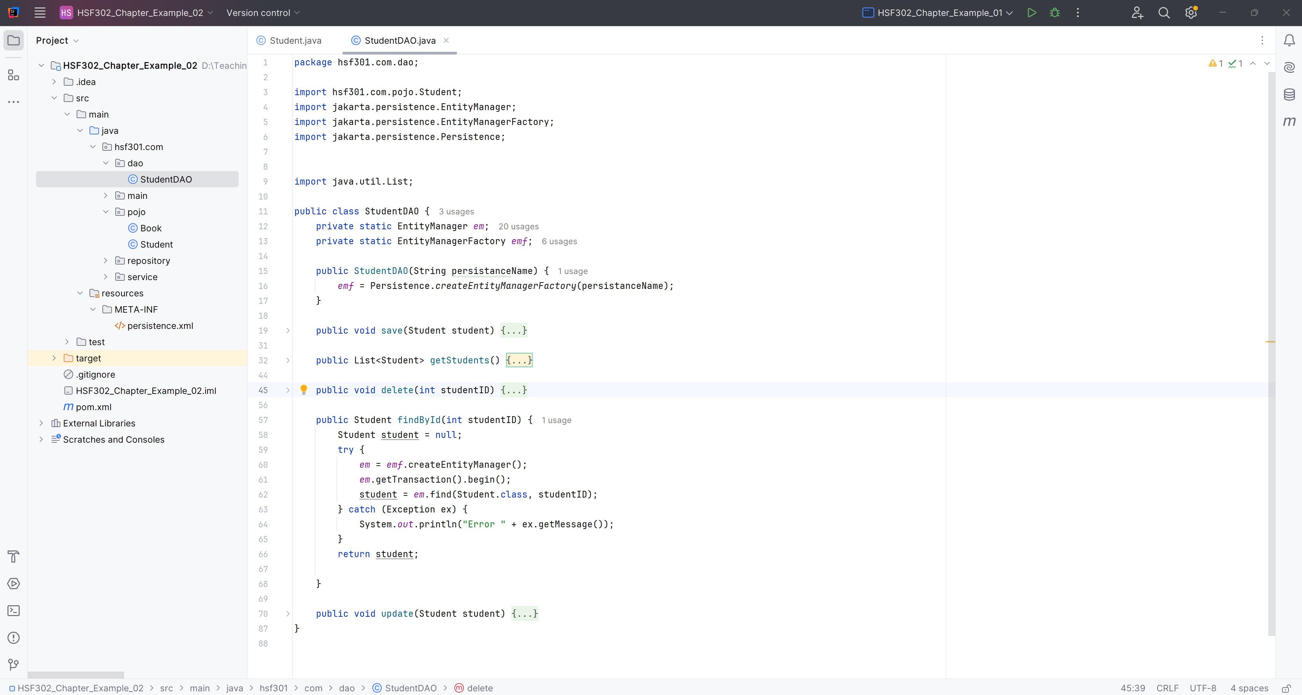
Get a Student in StudentDAO

Slide 62
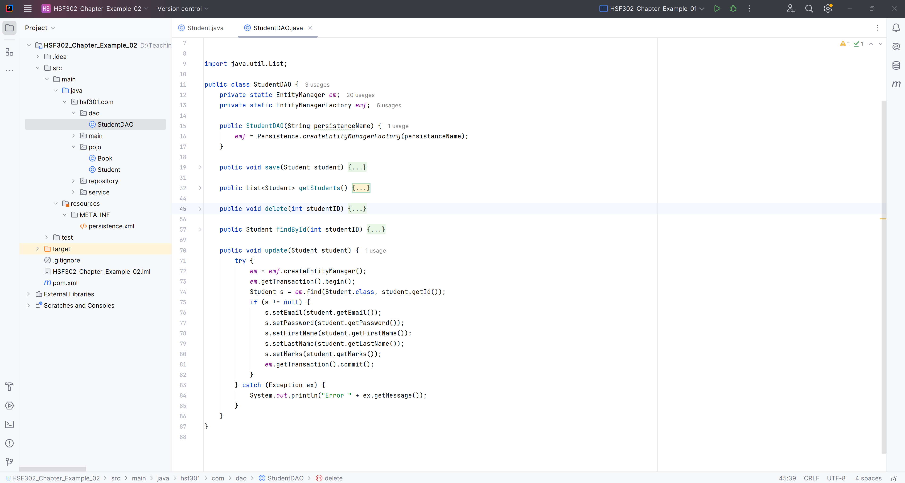
UpdateStudent in StudentDAO

Slide 63
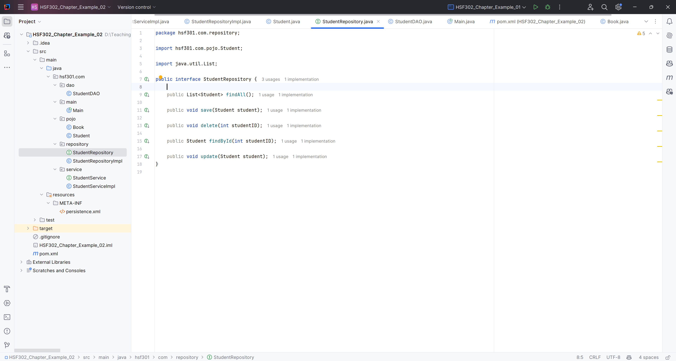
Create StudentRepository

Slide 64
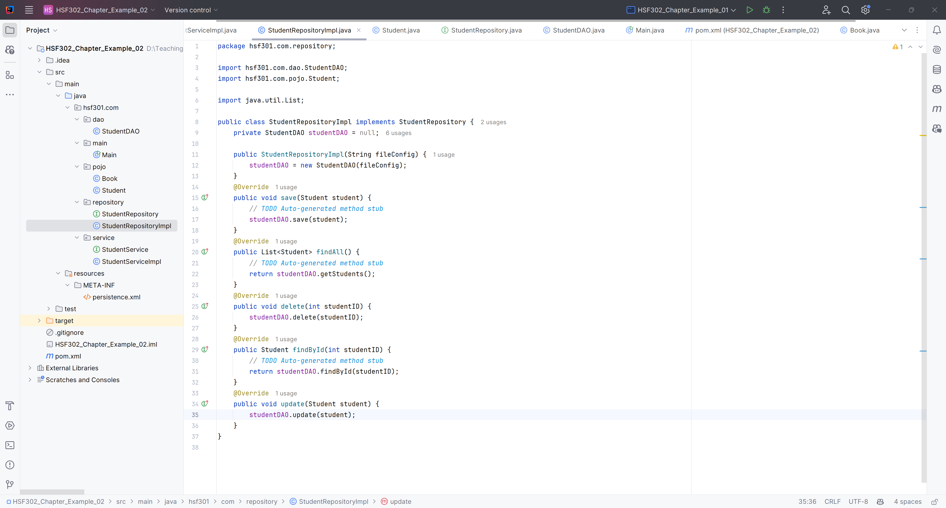
Create StudentRepositoryImpl

Slide 65
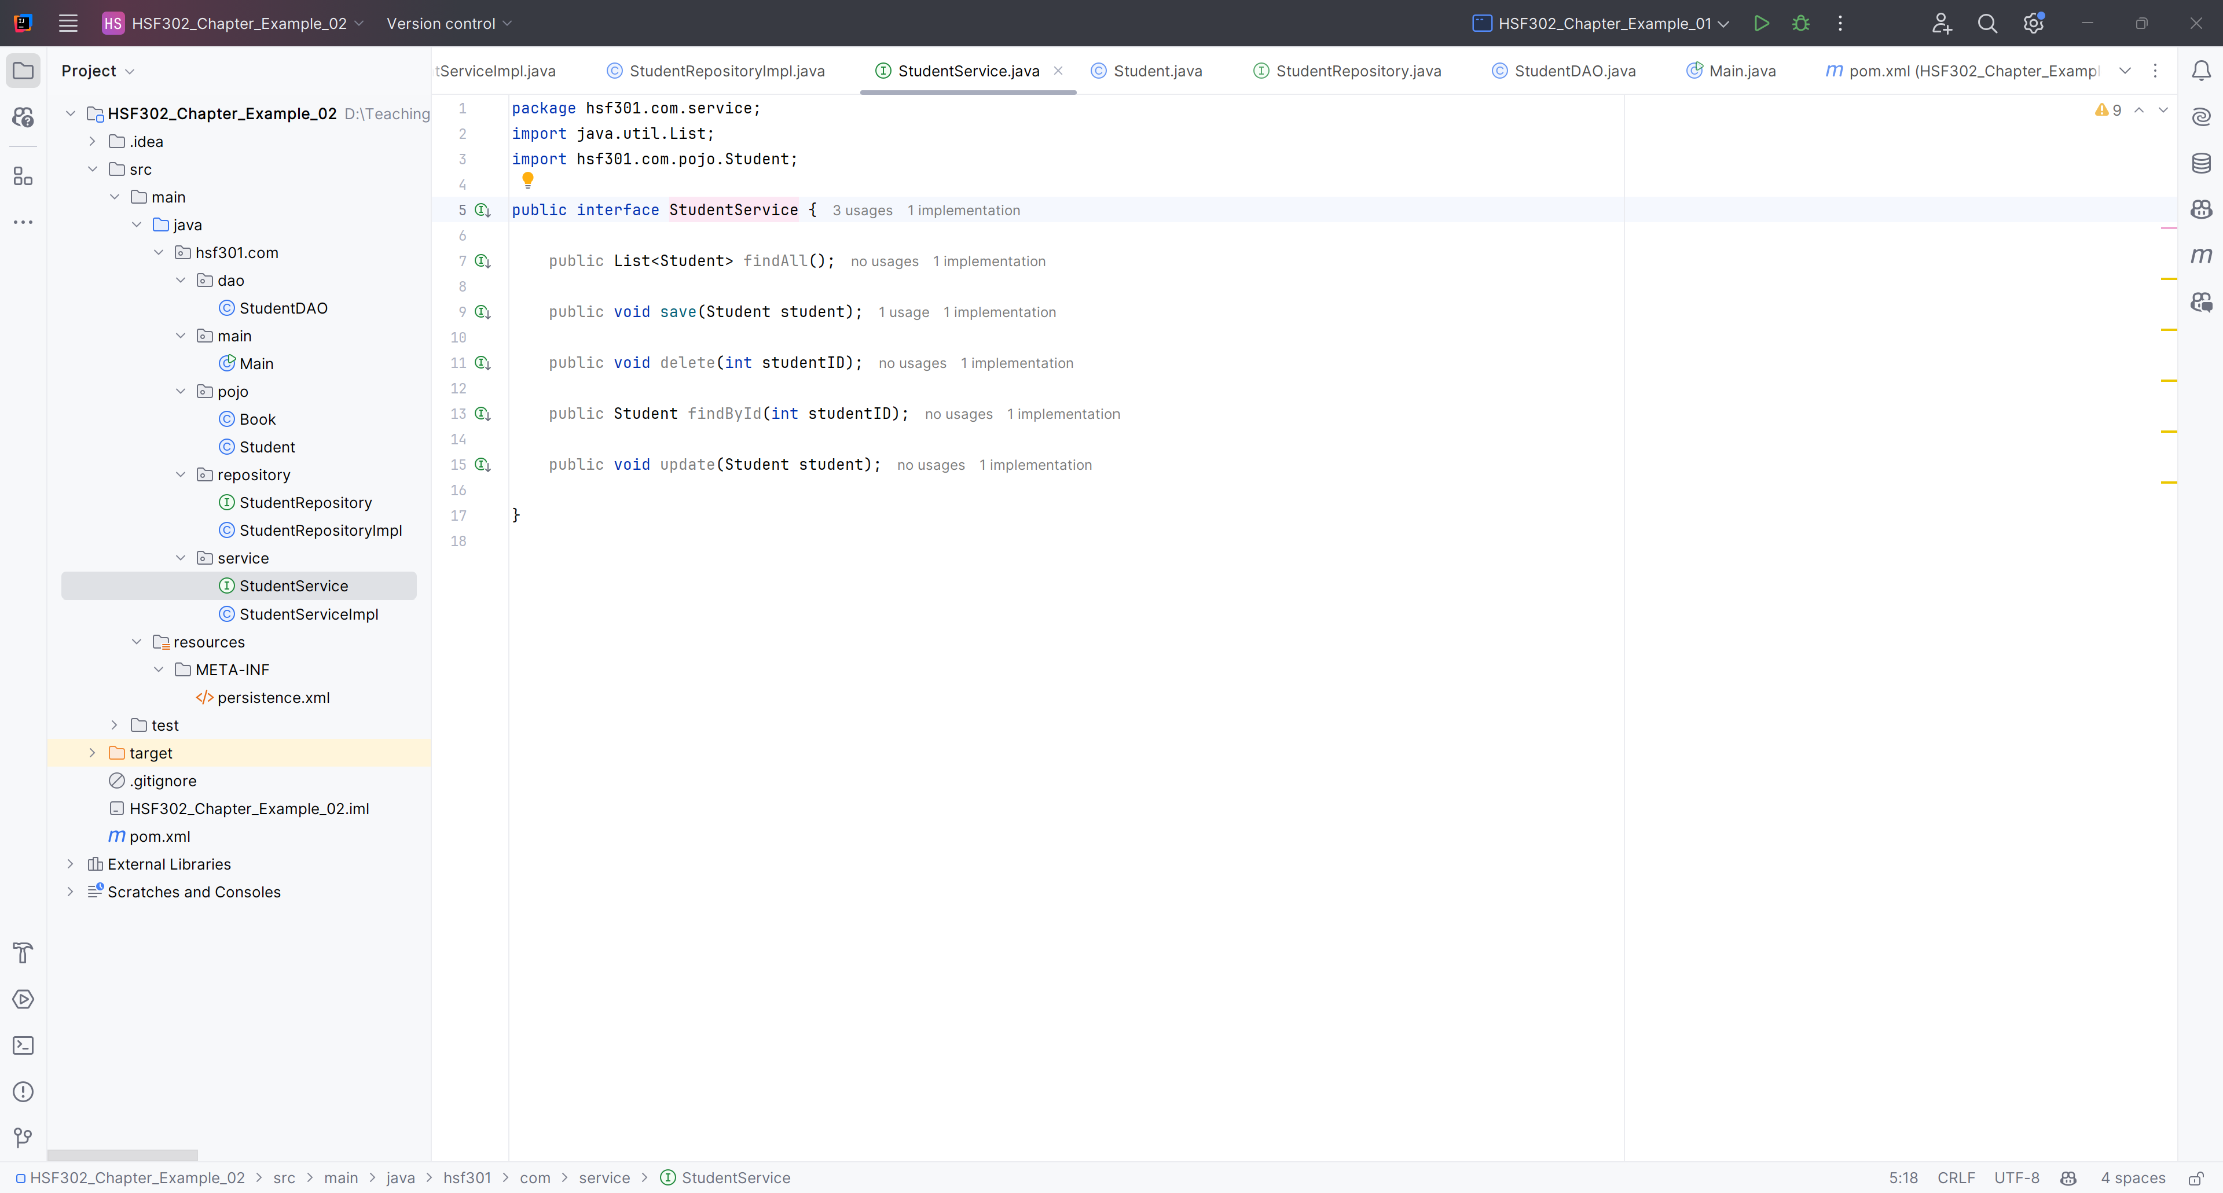
Create StudentService

Slide 66
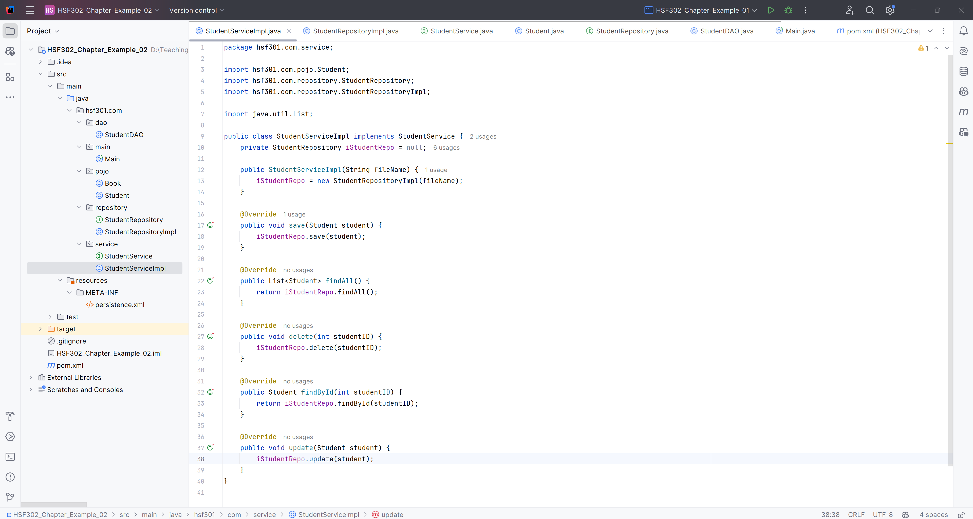
Create StudentServiceImpl

Slide 67
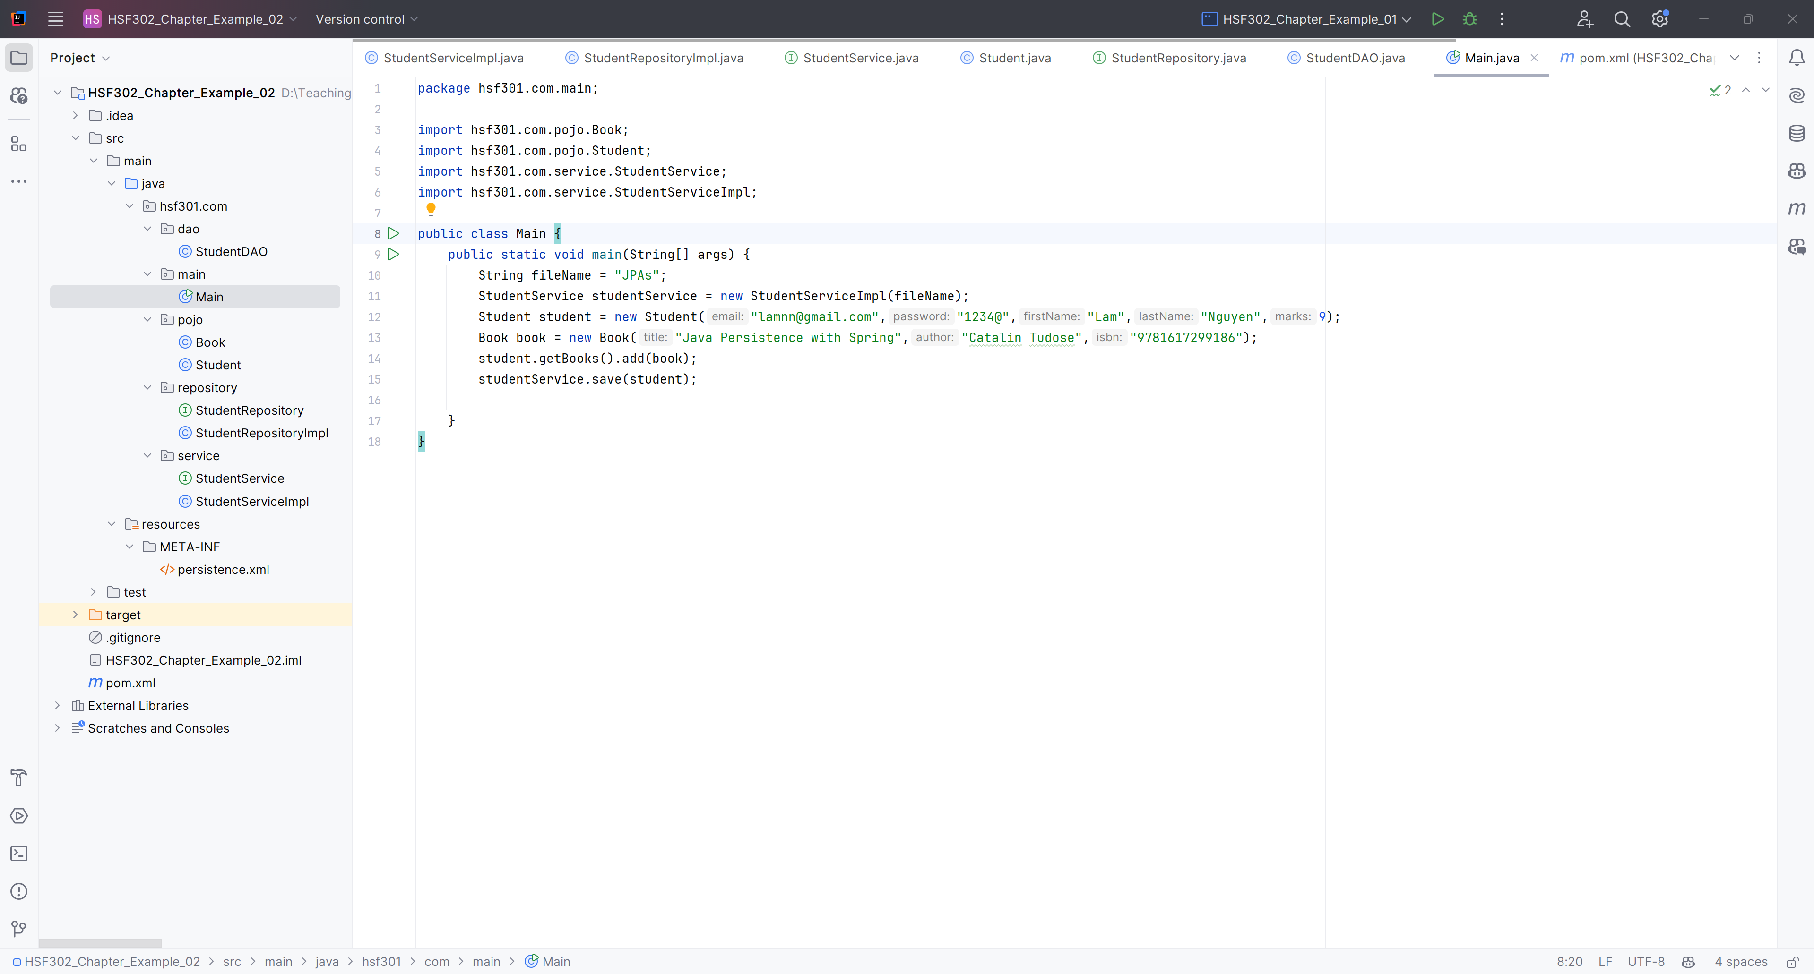
Create Main function

Slide 68
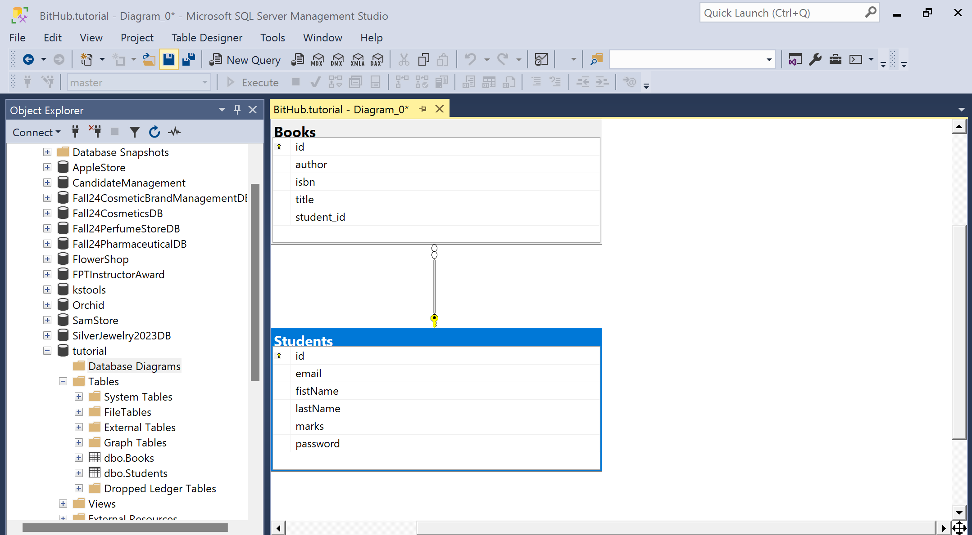
Result

Slide 69
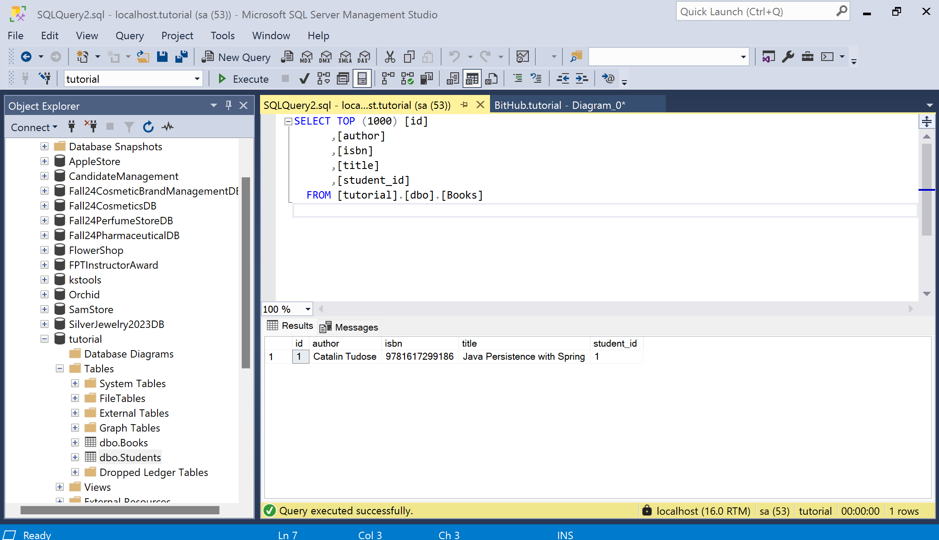
Result

Slide 70

Result

Slide 71
Demo JPA (Many To Many)

Slide 72

2. Create Student.java in Pojo’s Package

Slide 73

1. Create Book.java in Pojo’s Package

Slide 74

3. Run Program

Slide 75

4. Result

Slide 76

5. Result

Slide 77
Summary
Concepts were introduced:
Overview about JPA
Architecture Overview new features of JPA
Why JPA is selected as develop application?
Explain and demo using Eclipse IDE to create JPA Console App
Create and Run cross-platform Console application with Java connect to MSSQL with Repository Pattern

